Slide 1

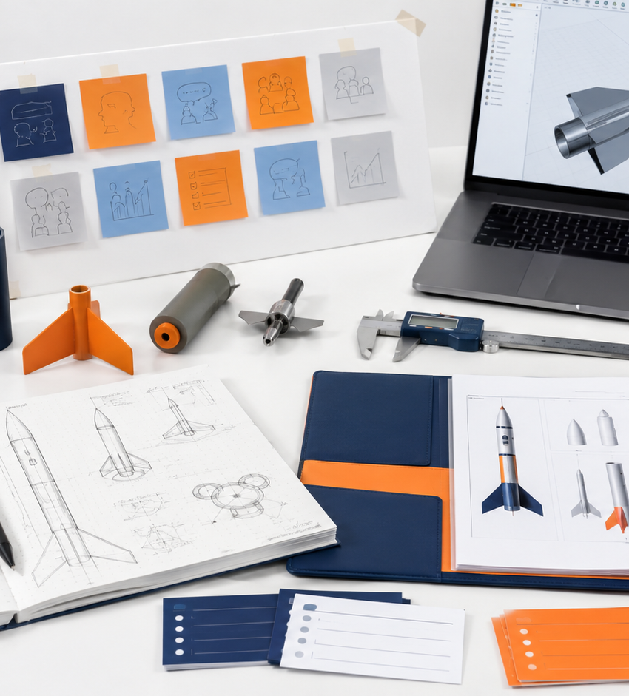
INTRODUCTION TO ENGINEERING DESIGN
Unit 5
Human-Centered Aerospace Design
Use user research, ethics, sustainability, project planning, testing, and presentation skills to complete a meaningful aerospace design challenge.
Student goal
Capstone focus
Design with people, evidence, and impact in mind.
From need finding to portfolio reflection.

Slide 2
UNIT 5
Roadmap
Unit 5 Learning Arc
This unit turns your engineering skills into a complete human-centered capstone story.
1
2
3
4
Understand people
Define requirements
Plan and build
Test and communicate
Stakeholders, users, interviews, and problem statements
Criteria, constraints, ethics, risk, sustainability, and success metrics
Team norms, project management, concepts, CAD, and prototypes
Data, iteration, final presentation, showcase, and portfolio
“
By the end of Unit 5, you will be able to explain not just what you made, but why it matters and how evidence shaped it.
Unit 5 • Human-Centered Aerospace Design
LockwoodSTEM

Slide 3
LESSON 5.1
Human-Centered Aerospace Design
Essential question
How do aerospace designers make solutions that work for real people, not just technical requirements?
What you will create
Human-centered design mindset notes
Unit 5 • Human-Centered Aerospace Design

Slide 4
LESSON 5.1
Core Ideas
What you need to understand
How do aerospace designers make solutions that work for real people, not just technical requirements?
Big ideas
•
Human-centered design starts with people, context, and purpose.
•
Aerospace problems often involve safety, reliability, access, cost, and communication.
•
A successful solution balances user needs with technical feasibility.
Use visuals as evidence and inspiration, not as a final answer.
“
Strong designs start with a clear understanding of people, requirements, and evidence.
Unit 5 • Lesson 5.1
LockwoodSTEM

Slide 5
LESSON 5.1
Process
How to approach the work
Use a repeatable process so your design decisions are clear and defensible.
1
Look beyond the object
Engineering habit
Identify who uses, supports, maintains, pays for, or is affected by the design.
Ask
Gather
Decide
Test
Iterate
2
Separate assumptions from evidence
Do not treat what you think users need as proof. Gather evidence.
3
Translate needs into requirements
Evidence loops back into the next decision.
Turn user problems into design criteria that can guide decisions.
When you cannot explain why a design changed, you may be iterating randomly instead of engineering intentionally.
Unit 5 • Lesson 5.1
LockwoodSTEM

Slide 6
LESSON 5.1
Apply It
What your work should show
Use this lesson to produce: Human-centered design mindset notes
Evidence checklist
Quality check
•
Define human-centered design in your own words.
Can another person understand what you decided, why it matters, and what evidence supports it?
•
Identify at least three user groups in an aerospace system.
Notebook / portfolio connection
Capture sketches, notes, tables, test results, photos, CAD screenshots, and reflections. Your final portfolio depends on evidence collected throughout the unit.
•
Explain how one design choice affects a user.
Unit 5 • Lesson 5.1
LockwoodSTEM

Slide 7
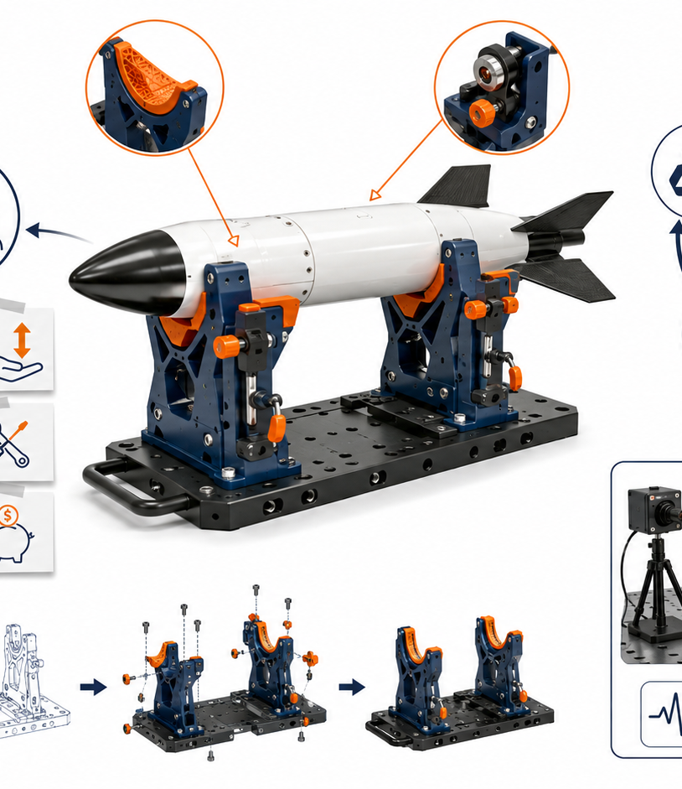
LESSON 5.2
Stakeholders, Users & Clients
Essential question
Who is affected by an aerospace design problem, and how can their needs conflict?
What you will create
Stakeholder map for a client problem
Unit 5 • Human-Centered Aerospace Design

Slide 8
LESSON 5.2
Core Ideas
What you need to understand
Who is affected by an aerospace design problem, and how can their needs conflict?
Big ideas
•
A user directly interacts with the design; a stakeholder is affected by it.
•
A client defines the problem but may not be the only important voice.
•
Needs may conflict, so engineers must prioritize and justify choices.
Use visuals as evidence and inspiration, not as a final answer.
“
Strong designs start with a clear understanding of people, requirements, and evidence.
Unit 5 • Lesson 5.2
LockwoodSTEM

Slide 9
LESSON 5.2
Process
How to approach the work
Use a repeatable process so your design decisions are clear and defensible.
1
Map the people
Engineering habit
List direct users, indirect users, operators, maintainers, decision makers, and people affected by failure.
Ask
Gather
Decide
Test
Iterate
2
Name the need
Write needs as what people must accomplish, not as a specific product.
3
Watch for conflicts
Evidence loops back into the next decision.
A feature that helps one stakeholder may create cost, safety, or usability issues for another.
When you cannot explain why a design changed, you may be iterating randomly instead of engineering intentionally.
Unit 5 • Lesson 5.2
LockwoodSTEM

Slide 10
LESSON 5.2
Apply It
What your work should show
Use this lesson to produce: Stakeholder map for a client problem
Evidence checklist
Quality check
•
Create a stakeholder map.
Can another person understand what you decided, why it matters, and what evidence supports it?
•
Label users, stakeholders, and client.
Notebook / portfolio connection
Capture sketches, notes, tables, test results, photos, CAD screenshots, and reflections. Your final portfolio depends on evidence collected throughout the unit.
•
List at least two conflicting needs.
Unit 5 • Lesson 5.2
LockwoodSTEM

Slide 11
LESSON 5.3
User Research & Empathy Interviews
Essential question
How can you learn what users actually need before designing a solution?
What you will create
Interview or observation plan
Unit 5 • Human-Centered Aerospace Design

Slide 12
LESSON 5.3
Core Ideas
What you need to understand
How can you learn what users actually need before designing a solution?
Big ideas
•
User research is evidence gathering, not opinion collecting.
•
Open-ended questions reveal context, frustrations, and priorities.
•
Observations can show problems users may not mention in an interview.
Use visuals as evidence and inspiration, not as a final answer.
“
Strong designs start with a clear understanding of people, requirements, and evidence.
Unit 5 • Lesson 5.3
LockwoodSTEM

Slide 13
LESSON 5.3
Process
How to approach the work
Use a repeatable process so your design decisions are clear and defensible.
1
Ask open questions
Engineering habit
Use prompts such as “Tell me about…” and “What makes this difficult?”
Ask
Gather
Decide
Test
Iterate
2
Avoid leading questions
Do not ask questions that push users toward your preferred solution.
3
Capture evidence
Evidence loops back into the next decision.
Record quotes, actions, pain points, and repeated patterns.
When you cannot explain why a design changed, you may be iterating randomly instead of engineering intentionally.
Unit 5 • Lesson 5.3
LockwoodSTEM

Slide 14
LESSON 5.3
Apply It
What your work should show
Use this lesson to produce: Interview or observation plan
Evidence checklist
Quality check
•
Write 6–8 interview questions.
Can another person understand what you decided, why it matters, and what evidence supports it?
•
Identify what evidence each question should reveal.
Notebook / portfolio connection
Capture sketches, notes, tables, test results, photos, CAD screenshots, and reflections. Your final portfolio depends on evidence collected throughout the unit.
•
Plan how notes will be documented.
Unit 5 • Lesson 5.3
LockwoodSTEM

Slide 15
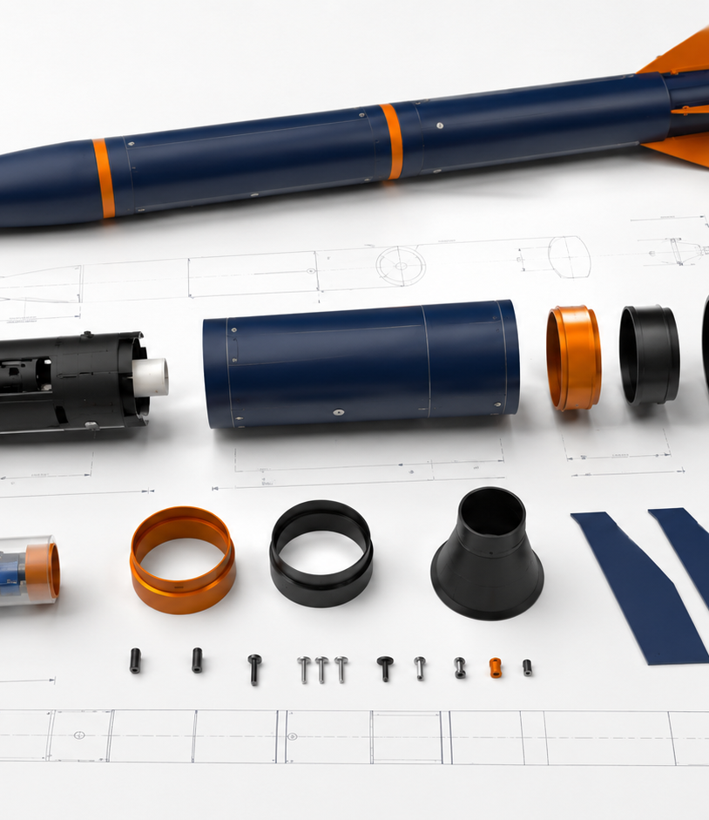
LESSON 5.4
Problem Statements & Design Briefs
Essential question
How do you turn user research into a clear engineering problem?
What you will create
Draft design brief
Unit 5 • Human-Centered Aerospace Design

Slide 16
LESSON 5.4
Core Ideas
What you need to understand
How do you turn user research into a clear engineering problem?
Big ideas
•
A strong problem statement names the user, need, and context.
•
A design brief explains what the solution must accomplish without naming the final design too early.
•
Clear problem framing prevents teams from solving the wrong problem.
Use visuals as evidence and inspiration, not as a final answer.
“
Strong designs start with a clear understanding of people, requirements, and evidence.
Unit 5 • Lesson 5.4
LockwoodSTEM

Slide 17
LESSON 5.4
Process
How to approach the work
Use a repeatable process so your design decisions are clear and defensible.
1
Use a problem frame
Engineering habit
User + need + context + reason the problem matters.
Ask
Gather
Decide
Test
Iterate
2
Avoid solution language
Do not write “build a bracket” if the real need is alignment, safety, or repeatability.
3
Check the scope
Evidence loops back into the next decision.
The problem must be large enough to matter and small enough to solve.
When you cannot explain why a design changed, you may be iterating randomly instead of engineering intentionally.
Unit 5 • Lesson 5.4
LockwoodSTEM

Slide 18
LESSON 5.4
Apply It
What your work should show
Use this lesson to produce: Draft design brief
Evidence checklist
Quality check
•
Write a first draft problem statement.
Can another person understand what you decided, why it matters, and what evidence supports it?
•
List the client or stakeholder need.
Notebook / portfolio connection
Capture sketches, notes, tables, test results, photos, CAD screenshots, and reflections. Your final portfolio depends on evidence collected throughout the unit.
•
Identify what success would look like.
Unit 5 • Lesson 5.4
LockwoodSTEM

Slide 19
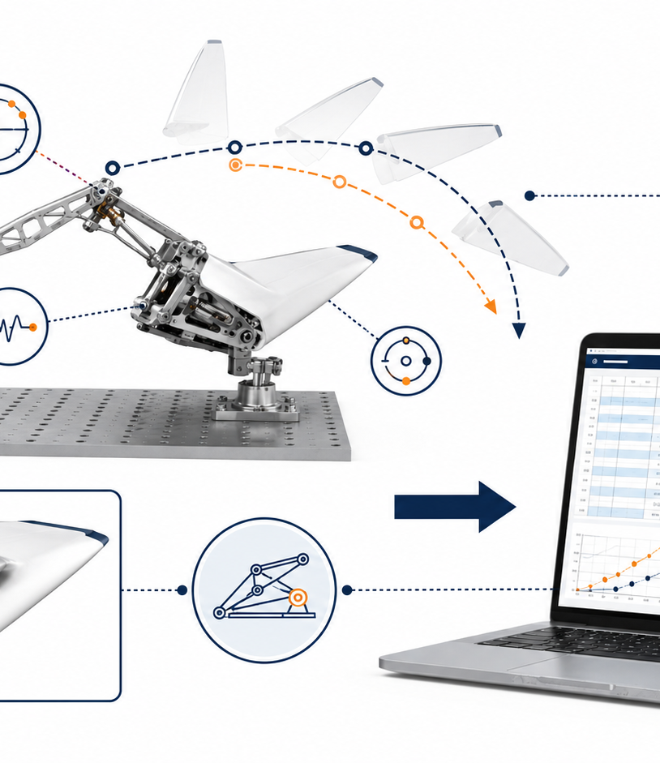
LESSON 5.5
Criteria, Constraints & Success Metrics
Essential question
How can design requirements be written so a solution can be tested fairly?
What you will create
Requirements table
Unit 5 • Human-Centered Aerospace Design

Slide 20
LESSON 5.5
Core Ideas
What you need to understand
How can design requirements be written so a solution can be tested fairly?
Big ideas
•
Criteria define what a successful solution should do.
•
Constraints define limits such as time, material, cost, tools, or safety.
•
Success metrics make requirements measurable.
Use visuals as evidence and inspiration, not as a final answer.
“
Strong designs start with a clear understanding of people, requirements, and evidence.
Unit 5 • Lesson 5.5
LockwoodSTEM

Slide 21
LESSON 5.5
Process
How to approach the work
Use a repeatable process so your design decisions are clear and defensible.
1
Make criteria measurable
Engineering habit
Replace “stable” with a measurable test such as “does not tip during three trials.”
Ask
Gather
Decide
Test
Iterate
2
Separate must-have from nice-to-have
Teams need to know what is required versus preferred.
3
Connect metrics to tests
Evidence loops back into the next decision.
Every major metric should have a planned way to measure it.
When you cannot explain why a design changed, you may be iterating randomly instead of engineering intentionally.
Unit 5 • Lesson 5.5
LockwoodSTEM

Slide 22
LESSON 5.5
Apply It
What your work should show
Use this lesson to produce: Requirements table
Evidence checklist
Quality check
•
Create a requirements table.
Can another person understand what you decided, why it matters, and what evidence supports it?
•
Label criteria and constraints.
Notebook / portfolio connection
Capture sketches, notes, tables, test results, photos, CAD screenshots, and reflections. Your final portfolio depends on evidence collected throughout the unit.
•
Write at least three measurable success metrics.
Unit 5 • Lesson 5.5
LockwoodSTEM

Slide 23
LESSON 5.6
Engineering Ethics in Aerospace
Essential question
What responsibilities do engineers have when designs affect safety, trust, and public systems?
What you will create
Ethics scenario response
Unit 5 • Human-Centered Aerospace Design

Slide 24
LESSON 5.6
Core Ideas
What you need to understand
What responsibilities do engineers have when designs affect safety, trust, and public systems?
Big ideas
•
Engineering decisions can affect safety, cost, access, and public trust.
•
Ethical design requires honesty about limitations, risks, and evidence.
•
Aerospace systems require careful documentation because failures can have serious consequences.
Use visuals as evidence and inspiration, not as a final answer.
“
Strong designs start with a clear understanding of people, requirements, and evidence.
Unit 5 • Lesson 5.6
LockwoodSTEM

Slide 25
LESSON 5.6
Process
How to approach the work
Use a repeatable process so your design decisions are clear and defensible.
1
Identify who could be harmed
Engineering habit
Consider users, operators, the public, and the environment.
Ask
Gather
Decide
Test
Iterate
2
Use evidence honestly
Do not exaggerate test results or hide known failure modes.
3
Escalate concerns
Evidence loops back into the next decision.
When a design may be unsafe, engineers must communicate clearly and early.
When you cannot explain why a design changed, you may be iterating randomly instead of engineering intentionally.
Unit 5 • Lesson 5.6
LockwoodSTEM

Slide 26
LESSON 5.6
Apply It
What your work should show
Use this lesson to produce: Ethics scenario response
Evidence checklist
Quality check
•
Analyze one aerospace ethics scenario.
Can another person understand what you decided, why it matters, and what evidence supports it?
•
Identify affected stakeholders.
Notebook / portfolio connection
Capture sketches, notes, tables, test results, photos, CAD screenshots, and reflections. Your final portfolio depends on evidence collected throughout the unit.
•
Write a justified decision or recommendation.
Unit 5 • Lesson 5.6
LockwoodSTEM

Slide 27
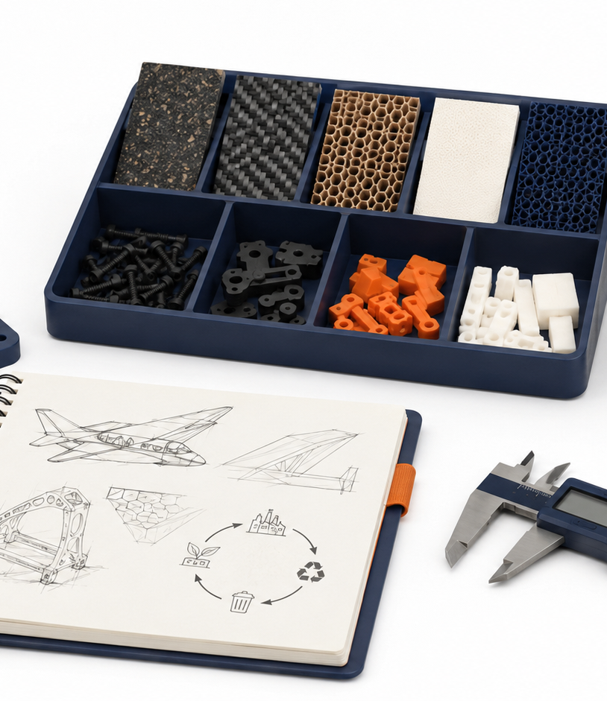
LESSON 5.7
Sustainability & Life-Cycle Thinking
Essential question
How can engineers reduce waste and environmental impact across a product’s life?
What you will create
Life-cycle analysis sketch
Unit 5 • Human-Centered Aerospace Design

Slide 28
LESSON 5.7
Core Ideas
What you need to understand
How can engineers reduce waste and environmental impact across a product’s life?
Big ideas
•
A product has impacts before, during, and after use.
•
Material choice, manufacturing method, repairability, and disposal all matter.
•
Sustainable design balances performance with responsible resource use.
Use visuals as evidence and inspiration, not as a final answer.
“
Strong designs start with a clear understanding of people, requirements, and evidence.
Unit 5 • Lesson 5.7
LockwoodSTEM

Slide 29
LESSON 5.7
Process
How to approach the work
Use a repeatable process so your design decisions are clear and defensible.
1
Trace the life cycle
Engineering habit
Raw materials → manufacturing → use → maintenance → end of life.
Ask
Gather
Decide
Test
Iterate
2
Look for waste points
Identify where material, energy, time, or replacements are wasted.
3
Design for repair or reuse
Evidence loops back into the next decision.
A part that can be replaced or repaired may reduce total impact.
When you cannot explain why a design changed, you may be iterating randomly instead of engineering intentionally.
Unit 5 • Lesson 5.7
LockwoodSTEM

Slide 30
LESSON 5.7
Apply It
What your work should show
Use this lesson to produce: Life-cycle analysis sketch
Evidence checklist
Quality check
•
Create a life-cycle diagram.
Can another person understand what you decided, why it matters, and what evidence supports it?
•
Identify one design choice that reduces waste.
Notebook / portfolio connection
Capture sketches, notes, tables, test results, photos, CAD screenshots, and reflections. Your final portfolio depends on evidence collected throughout the unit.
•
Explain a tradeoff between performance and sustainability.
Unit 5 • Lesson 5.7
LockwoodSTEM

Slide 31
LESSON 5.8
Safety, Risk & Failure Modes
Essential question
How can you predict what might go wrong before testing a prototype?
What you will create
Failure mode table
Unit 5 • Human-Centered Aerospace Design

Slide 32
LESSON 5.8
Core Ideas
What you need to understand
How can you predict what might go wrong before testing a prototype?
Big ideas
•
A failure mode is a specific way a design could fail.
•
Risk depends on both likelihood and consequence.
•
Good testing plans focus on the most important risks first.
Use visuals as evidence and inspiration, not as a final answer.
“
Strong designs start with a clear understanding of people, requirements, and evidence.
Unit 5 • Lesson 5.8
LockwoodSTEM

Slide 33
LESSON 5.8
Process
How to approach the work
Use a repeatable process so your design decisions are clear and defensible.
1
List failure modes
Engineering habit
Think about breaking, slipping, tipping, binding, overheating, confusing use, or unsafe misuse.
Ask
Gather
Decide
Test
Iterate
2
Rate risk
Rank the likelihood and severity of each failure.
3
Plan mitigation
Evidence loops back into the next decision.
Change the design, add instructions, strengthen a part, or improve the test.
When you cannot explain why a design changed, you may be iterating randomly instead of engineering intentionally.
Unit 5 • Lesson 5.8
LockwoodSTEM

Slide 34
LESSON 5.8
Apply It
What your work should show
Use this lesson to produce: Failure mode table
Evidence checklist
Quality check
•
Identify at least five possible failure modes.
Can another person understand what you decided, why it matters, and what evidence supports it?
•
Rate risk for each.
Notebook / portfolio connection
Capture sketches, notes, tables, test results, photos, CAD screenshots, and reflections. Your final portfolio depends on evidence collected throughout the unit.
•
Choose two design changes or controls.
Unit 5 • Lesson 5.8
LockwoodSTEM

Slide 35
LESSON 5.9
Team Norms & Project Roles
Essential question
How do design teams organize work so every member contributes to the final solution?
What you will create
Team contract and role plan
Unit 5 • Human-Centered Aerospace Design

Slide 36
LESSON 5.9
Core Ideas
What you need to understand
How do design teams organize work so every member contributes to the final solution?
Big ideas
•
Team norms describe how the group communicates and makes decisions.
•
Roles help divide responsibility without isolating team members.
•
Strong teams document decisions and hold each other accountable.
Use visuals as evidence and inspiration, not as a final answer.
“
Strong designs start with a clear understanding of people, requirements, and evidence.
Unit 5 • Lesson 5.9
LockwoodSTEM

Slide 37
LESSON 5.9
Process
How to approach the work
Use a repeatable process so your design decisions are clear and defensible.
1
Agree on norms
Engineering habit
Set expectations for communication, attendance, shared work, and conflict.
Ask
Gather
Decide
Test
Iterate
2
Assign responsibilities
Use roles such as project manager, CAD lead, documentation lead, testing lead, and presentation lead.
3
Track decisions
Evidence loops back into the next decision.
Record what changed, why it changed, and who is responsible for next steps.
When you cannot explain why a design changed, you may be iterating randomly instead of engineering intentionally.
Unit 5 • Lesson 5.9
LockwoodSTEM

Slide 38
LESSON 5.9
Apply It
What your work should show
Use this lesson to produce: Team contract and role plan
Evidence checklist
Quality check
•
Write team norms.
Can another person understand what you decided, why it matters, and what evidence supports it?
•
Assign roles and backups.
Notebook / portfolio connection
Capture sketches, notes, tables, test results, photos, CAD screenshots, and reflections. Your final portfolio depends on evidence collected throughout the unit.
•
Create a simple responsibility tracker.
Unit 5 • Lesson 5.9
LockwoodSTEM

Slide 39

LESSON 5.10
Project Management & Milestones
Essential question
How can a team break a large design project into manageable steps?
What you will create
Project timeline with milestones
Unit 5 • Human-Centered Aerospace Design

Slide 40
LESSON 5.10
Core Ideas
What you need to understand
How can a team break a large design project into manageable steps?
Big ideas
•
Milestones are checkpoints that show progress toward the final deliverable.
•
A good plan includes dependencies: some tasks must happen before others.
•
Project management is a design skill, not paperwork.
Use visuals as evidence and inspiration, not as a final answer.
“
Strong designs start with a clear understanding of people, requirements, and evidence.
Unit 5 • Lesson 5.10
LockwoodSTEM

Slide 41
LESSON 5.10
Process
How to approach the work
Use a repeatable process so your design decisions are clear and defensible.
1
Start with the deadline
Engineering habit
Work backward from the final presentation and prototype due dates.
Ask
Gather
Decide
Test
Iterate
2
Build checkpoints
Include research, concept selection, CAD, prototype, test, iteration, and presentation milestones.
3
Adjust based on evidence
Evidence loops back into the next decision.
A plan should change when testing reveals new information.
When you cannot explain why a design changed, you may be iterating randomly instead of engineering intentionally.
Unit 5 • Lesson 5.10
LockwoodSTEM

Slide 42
LESSON 5.10
Apply It
What your work should show
Use this lesson to produce: Project timeline with milestones
Evidence checklist
Quality check
•
Create a milestone timeline.
Can another person understand what you decided, why it matters, and what evidence supports it?
•
List task owners.
Notebook / portfolio connection
Capture sketches, notes, tables, test results, photos, CAD screenshots, and reflections. Your final portfolio depends on evidence collected throughout the unit.
•
Identify the next three actions for the team.
Unit 5 • Lesson 5.10
LockwoodSTEM

Slide 43
LESSON 5.11
Concept Generation for Client Problems
Essential question
How can teams create multiple solution ideas before choosing one direction?
What you will create
Individual and team concept sketches
Unit 5 • Human-Centered Aerospace Design

Slide 44
LESSON 5.11
Core Ideas
What you need to understand
How can teams create multiple solution ideas before choosing one direction?
Big ideas
•
Strong teams generate many ideas before narrowing.
•
Different sketches can explore different functions, users, or constraints.
•
Early concepts should be fast, visual, and imperfect.
Use visuals as evidence and inspiration, not as a final answer.
“
Strong designs start with a clear understanding of people, requirements, and evidence.
Unit 5 • Lesson 5.11
LockwoodSTEM

Slide 45
LESSON 5.11
Process
How to approach the work
Use a repeatable process so your design decisions are clear and defensible.
1
Sketch individually first
Engineering habit
Individual thinking prevents the group from settling too early.
Ask
Gather
Decide
Test
Iterate
2
Share and combine
Look for useful features from multiple ideas.
3
Create concept families
Evidence loops back into the next decision.
Group ideas by strategy: support, protect, align, store, guide, move, or measure.
When you cannot explain why a design changed, you may be iterating randomly instead of engineering intentionally.
Unit 5 • Lesson 5.11
LockwoodSTEM

Slide 46
LESSON 5.11
Apply It
What your work should show
Use this lesson to produce: Individual and team concept sketches
Evidence checklist
Quality check
•
Create individual concept sketches.
Can another person understand what you decided, why it matters, and what evidence supports it?
•
Share and annotate team ideas.
Notebook / portfolio connection
Capture sketches, notes, tables, test results, photos, CAD screenshots, and reflections. Your final portfolio depends on evidence collected throughout the unit.
•
Combine parts of multiple concepts into a team direction.
Unit 5 • Lesson 5.11
LockwoodSTEM

Slide 47
LESSON 5.12
Decision Matrices & Justification
Essential question
How can design teams choose a concept using evidence instead of preference?
What you will create
Decision matrix and recommendation
Unit 5 • Human-Centered Aerospace Design

Slide 48
LESSON 5.12
Core Ideas
What you need to understand
How can design teams choose a concept using evidence instead of preference?
Big ideas
•
A decision matrix compares concepts against weighted criteria.
•
Scores should be based on evidence, not popularity.
•
Justification explains why the selected idea best meets the problem.
Use visuals as evidence and inspiration, not as a final answer.
“
Strong designs start with a clear understanding of people, requirements, and evidence.
Unit 5 • Lesson 5.12
LockwoodSTEM

Slide 49
LESSON 5.12
Process
How to approach the work
Use a repeatable process so your design decisions are clear and defensible.
1
Choose criteria carefully
Engineering habit
Use requirements from the design brief, not random preferences.
Ask
Gather
Decide
Test
Iterate
2
Weight what matters most
Safety or usability may deserve more weight than appearance.
3
Explain the result
Evidence loops back into the next decision.
A matrix supports a decision, but the team must still justify tradeoffs.
When you cannot explain why a design changed, you may be iterating randomly instead of engineering intentionally.
Unit 5 • Lesson 5.12
LockwoodSTEM

Slide 50
LESSON 5.12
Apply It
What your work should show
Use this lesson to produce: Decision matrix and recommendation
Evidence checklist
Quality check
•
Build a decision matrix.
Can another person understand what you decided, why it matters, and what evidence supports it?
•
Score at least three concepts.
Notebook / portfolio connection
Capture sketches, notes, tables, test results, photos, CAD screenshots, and reflections. Your final portfolio depends on evidence collected throughout the unit.
•
Write a short recommendation.
Unit 5 • Lesson 5.12
LockwoodSTEM

Slide 51
LESSON 5.13
Low-Fidelity Prototyping
Essential question
How can quick prototypes answer design questions before committing to a final build?
What you will create
Low-fidelity prototype and test notes
Unit 5 • Human-Centered Aerospace Design

Slide 52
LESSON 5.13
Core Ideas
What you need to understand
How can quick prototypes answer design questions before committing to a final build?
Big ideas
•
Low-fidelity prototypes are quick, rough, and useful.
•
A prototype should answer a specific question.
•
Early prototypes reduce risk before a team spends time on detailed CAD or fabrication.
Use visuals as evidence and inspiration, not as a final answer.
“
Strong designs start with a clear understanding of people, requirements, and evidence.
Unit 5 • Lesson 5.13
LockwoodSTEM

Slide 53
LESSON 5.13
Process
How to approach the work
Use a repeatable process so your design decisions are clear and defensible.
1
Prototype one question
Engineering habit
Focus on fit, reach, stability, layout, motion, or user interaction.
Ask
Gather
Decide
Test
Iterate
2
Use quick materials
Cardboard, paper, tape, scrap parts, or simple prints can reveal major issues.
3
Observe use
Evidence loops back into the next decision.
Watch how someone interacts with the prototype and record what happens.
When you cannot explain why a design changed, you may be iterating randomly instead of engineering intentionally.
Unit 5 • Lesson 5.13
LockwoodSTEM

Slide 54
LESSON 5.13
Apply It
What your work should show
Use this lesson to produce: Low-fidelity prototype and test notes
Evidence checklist
Quality check
•
Build or sketch a low-fidelity prototype.
Can another person understand what you decided, why it matters, and what evidence supports it?
•
Write the question it tests.
Notebook / portfolio connection
Capture sketches, notes, tables, test results, photos, CAD screenshots, and reflections. Your final portfolio depends on evidence collected throughout the unit.
•
Record observations and improvement ideas.
Unit 5 • Lesson 5.13
LockwoodSTEM

Slide 55
LESSON 5.14
CAD Development & Prototype Planning
Essential question
How do teams move from concept to a manufacturable prototype?
What you will create
CAD plan and fabrication checklist
Unit 5 • Human-Centered Aerospace Design

Slide 56
LESSON 5.14
Core Ideas
What you need to understand
How do teams move from concept to a manufacturable prototype?
Big ideas
•
CAD should communicate design intent, not just shape.
•
Prototype plans must consider dimensions, tolerances, materials, and assembly.
•
Manufacturing decisions affect cost, time, quality, and reliability.
Use visuals as evidence and inspiration, not as a final answer.
“
Strong designs start with a clear understanding of people, requirements, and evidence.
Unit 5 • Lesson 5.14
LockwoodSTEM

Slide 57
LESSON 5.14
Process
How to approach the work
Use a repeatable process so your design decisions are clear and defensible.
1
Build from requirements
Engineering habit
Use criteria and constraints to decide features and dimensions.
Ask
Gather
Decide
Test
Iterate
2
Plan assemblies
Identify how parts connect, align, fasten, or move.
3
Check before fabrication
Evidence loops back into the next decision.
Review size, print orientation, material, tool access, and safety.
When you cannot explain why a design changed, you may be iterating randomly instead of engineering intentionally.
Unit 5 • Lesson 5.14
LockwoodSTEM

Slide 58
LESSON 5.14
Apply It
What your work should show
Use this lesson to produce: CAD plan and fabrication checklist
Evidence checklist
Quality check
•
Create a CAD development plan.
Can another person understand what you decided, why it matters, and what evidence supports it?
•
List parts to make or modify.
Notebook / portfolio connection
Capture sketches, notes, tables, test results, photos, CAD screenshots, and reflections. Your final portfolio depends on evidence collected throughout the unit.
•
Complete a fabrication readiness checklist.
Unit 5 • Lesson 5.14
LockwoodSTEM

Slide 59
LESSON 5.15
Testing Plans & Data Collection
Essential question
How can testing prove whether a design meets the requirements?
What you will create
Test plan and data table
Unit 5 • Human-Centered Aerospace Design

Slide 60
LESSON 5.15
Core Ideas
What you need to understand
How can testing prove whether a design meets the requirements?
Big ideas
•
Testing must connect directly to success metrics.
•
Good data is repeatable, organized, and tied to a clear procedure.
•
A failed test is useful if it tells the team what to improve.
Use visuals as evidence and inspiration, not as a final answer.
“
Strong designs start with a clear understanding of people, requirements, and evidence.
Unit 5 • Lesson 5.15
LockwoodSTEM

Slide 61
LESSON 5.15
Process
How to approach the work
Use a repeatable process so your design decisions are clear and defensible.
1
Write the procedure
Engineering habit
Define setup, variables, number of trials, and what will be measured.
Ask
Gather
Decide
Test
Iterate
2
Collect clean data
Use tables, units, labels, and consistent measurement methods.
3
Compare to requirements
Evidence loops back into the next decision.
Decide whether results meet, exceed, or fall short of criteria.
When you cannot explain why a design changed, you may be iterating randomly instead of engineering intentionally.
Unit 5 • Lesson 5.15
LockwoodSTEM

Slide 62
LESSON 5.15
Apply It
What your work should show
Use this lesson to produce: Test plan and data table
Evidence checklist
Quality check
•
Write a test plan.
Can another person understand what you decided, why it matters, and what evidence supports it?
•
Create a data table with units.
Notebook / portfolio connection
Capture sketches, notes, tables, test results, photos, CAD screenshots, and reflections. Your final portfolio depends on evidence collected throughout the unit.
•
Explain how results will be judged.
Unit 5 • Lesson 5.15
LockwoodSTEM

Slide 63
LESSON 5.16
Iteration & Final Design Decisions
Essential question
How should teams use feedback and test data to improve the design?
What you will create
Iteration log and final design update
Unit 5 • Human-Centered Aerospace Design

Slide 64
LESSON 5.16
Core Ideas
What you need to understand
How should teams use feedback and test data to improve the design?
Big ideas
•
Iteration is purposeful change based on evidence.
•
A final design should reflect what the team learned from users and tests.
•
Every major change should be documented and justified.
Use visuals as evidence and inspiration, not as a final answer.
“
Strong designs start with a clear understanding of people, requirements, and evidence.
Unit 5 • Lesson 5.16
LockwoodSTEM

Slide 65
LESSON 5.16
Process
How to approach the work
Use a repeatable process so your design decisions are clear and defensible.
1
Review evidence
Engineering habit
Use test results, user feedback, and failure modes to decide what must change.
Ask
Gather
Decide
Test
Iterate
2
Prioritize improvements
Fix high-risk, high-impact issues before cosmetic changes.
3
Document revisions
Evidence loops back into the next decision.
Show before/after changes and explain the reason for each.
When you cannot explain why a design changed, you may be iterating randomly instead of engineering intentionally.
Unit 5 • Lesson 5.16
LockwoodSTEM

Slide 66
LESSON 5.16
Apply It
What your work should show
Use this lesson to produce: Iteration log and final design update
Evidence checklist
Quality check
•
Create an iteration log.
Can another person understand what you decided, why it matters, and what evidence supports it?
•
Identify the final design changes.
Notebook / portfolio connection
Capture sketches, notes, tables, test results, photos, CAD screenshots, and reflections. Your final portfolio depends on evidence collected throughout the unit.
•
Explain what evidence drove each change.
Unit 5 • Lesson 5.16
LockwoodSTEM

Slide 67
LESSON 5.17
Final Presentation & Storytelling
Essential question
How can a design team clearly communicate the problem, evidence, solution, and impact?
What you will create
Final presentation draft
Unit 5 • Human-Centered Aerospace Design

Slide 68
LESSON 5.17
Core Ideas
What you need to understand
How can a design team clearly communicate the problem, evidence, solution, and impact?
Big ideas
•
A strong presentation tells the story of the design process.
•
Evidence matters more than describing every step.
•
The audience needs to understand why the final solution is justified.
Use visuals as evidence and inspiration, not as a final answer.
“
Strong designs start with a clear understanding of people, requirements, and evidence.
Unit 5 • Lesson 5.17
LockwoodSTEM

Slide 69
LESSON 5.17
Process
How to approach the work
Use a repeatable process so your design decisions are clear and defensible.
1
Start with the problem
Engineering habit
Explain who needed help and why the problem mattered.
Ask
Gather
Decide
Test
Iterate
2
Show key evidence
Use research, requirements, testing, and iteration to support claims.
3
End with impact
Evidence loops back into the next decision.
Explain how the final design meets user needs and what could improve next.
When you cannot explain why a design changed, you may be iterating randomly instead of engineering intentionally.
Unit 5 • Lesson 5.17
LockwoodSTEM

Slide 70
LESSON 5.17
Apply It
What your work should show
Use this lesson to produce: Final presentation draft
Evidence checklist
Quality check
•
Draft final presentation slides.
Can another person understand what you decided, why it matters, and what evidence supports it?
•
Add evidence visuals.
Notebook / portfolio connection
Capture sketches, notes, tables, test results, photos, CAD screenshots, and reflections. Your final portfolio depends on evidence collected throughout the unit.
•
Practice a concise explanation of the final design.
Unit 5 • Lesson 5.17
LockwoodSTEM

Slide 71
LESSON 5.18
Portfolio, Showcase & Reflection
Essential question
How can you use a finished project to show growth as an engineering designer?
What you will create
Final portfolio entry and reflection
Unit 5 • Human-Centered Aerospace Design

Slide 72
LESSON 5.18
Core Ideas
What you need to understand
How can you use a finished project to show growth as an engineering designer?
Big ideas
•
A portfolio shows process, not just the final object.
•
Reflection helps you identify what you learned and what you would improve.
•
Engineering evidence includes sketches, CAD, prototypes, tests, decisions, and communication.
Use visuals as evidence and inspiration, not as a final answer.
“
Strong designs start with a clear understanding of people, requirements, and evidence.
Unit 5 • Lesson 5.18
LockwoodSTEM

Slide 73
LESSON 5.18
Process
How to approach the work
Use a repeatable process so your design decisions are clear and defensible.
1
Select strong artifacts
Engineering habit
Choose items that show research, design decisions, prototyping, testing, and iteration.
Ask
Gather
Decide
Test
Iterate
2
Explain your role
Describe what you contributed and how you helped the team improve.
3
Reflect honestly
Evidence loops back into the next decision.
Use specific evidence to show growth, challenges, and next steps.
When you cannot explain why a design changed, you may be iterating randomly instead of engineering intentionally.
Unit 5 • Lesson 5.18
LockwoodSTEM

Slide 74
LESSON 5.18
Apply It
What your work should show
Use this lesson to produce: Final portfolio entry and reflection
Evidence checklist
Quality check
•
Create a final portfolio entry.
Can another person understand what you decided, why it matters, and what evidence supports it?
•
Prepare for the showcase.
Notebook / portfolio connection
Capture sketches, notes, tables, test results, photos, CAD screenshots, and reflections. Your final portfolio depends on evidence collected throughout the unit.
•
Write an individual reflection on your engineering growth.
Unit 5 • Lesson 5.18
LockwoodSTEM

Slide 75
UNIT 5 WRAP-UP
Your final design story
A finished prototype is only part of the work. The complete engineering story includes the problem, users, requirements, decisions, tests, iteration, and impact.
Problem
Evidence
Design
Test
Impact
Portfolio reminder
Show your process clearly enough that someone outside your team can understand and trust your decisions.

