Slide 1

Introduction to Engineering Design
Unit 1: Technical Sketching & Engineering Documentation
Student learning deck • LockwoodSTEM aerospace-aligned IED curriculum
Module
Skills
Challenge
Sketching, measurement, line conventions, views, and documentation.
Isometric sketching, orthographic projection, dimensioning, and reverse engineering.
Document and propose improvements to a 3D printed rocket assembly.
Sketch • Measure • Document • Communicate

Slide 2
LOCKWOODSTEM
Unit 1
Unit 1 Learning Arc
Technical sketching becomes engineering evidence when it is accurate, labeled, measured, and documented.
Lesson range | Focus | Purpose
1.1–1.6 | Sketching language | Use line types, isometric views, hidden lines, and centerlines to communicate shape.
1.7–1.10 | Views + dimensions | Use orthographic views and dimensions to describe size and geometry clearly.
1.11–1.20 | Rocket documentation | Reverse engineer a 3D printed rocket through sketches, measurements, BOM, and notes.
1.21–1.22 | Design proposal | Use evidence to propose a rocket assembly improvement and communicate it clearly.
Core idea
You are learning to communicate engineering decisions clearly enough that another person could inspect, build, or improve the design.
LockwoodSTEM | Introduction to Engineering Design | Unit 1

Slide 3
LOCKWOODSTEM
Unit 1
Unit 1 Deliverables Map
You will build a documentation package, not just complete isolated sketches.
Checkpoint | Student evidence
Sketching practice | Line conventions, isometric views, hidden-line sketches, centerlines, and shading.
Technical views | Orthographic views, dimensions, bracket sketches, and measurement notes.
Rocket documentation | Reverse-engineering notes, parts list, exploded view, assembly notes, and BOM.
Final proposal | Engineering Change Request and rocket assembly improvement presentation.
Evidence expectation
Each artifact should be dated, labeled, and clear enough to stand alone as engineering evidence.
LockwoodSTEM | Introduction to Engineering Design | Unit 1

Slide 4
LOCKWOODSTEM
Unit 1
How Unit 1 Works
Every lesson should improve the evidence you can use later.
What you are practicing
First, learn the visual language engineers use to communicate shape and structure.
Next, apply that language to aerospace-style parts and rocket components.
Then, combine sketches, measurements, views, and notes into a complete documentation package.
Finally, use your evidence to justify one proposed improvement to the rocket assembly.
Remember
A good sketch is not judged by whether it is artistic. It is judged by whether it communicates the design clearly.
LockwoodSTEM | Introduction to Engineering Design | Unit 1

Slide 5
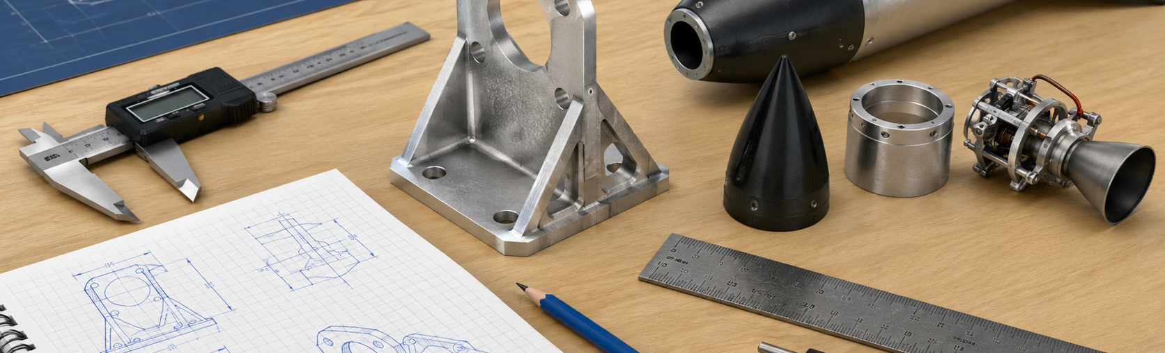
LOCKWOODSTEM
Lesson 1.1
Why Engineers Sketch
Why do engineers sketch before they build or model in CAD?
Lesson 1.1
Why Engineers Sketch
Connect today’s work to your engineering notebook evidence.
LockwoodSTEM | Introduction to Engineering Design | Unit 1

Slide 6
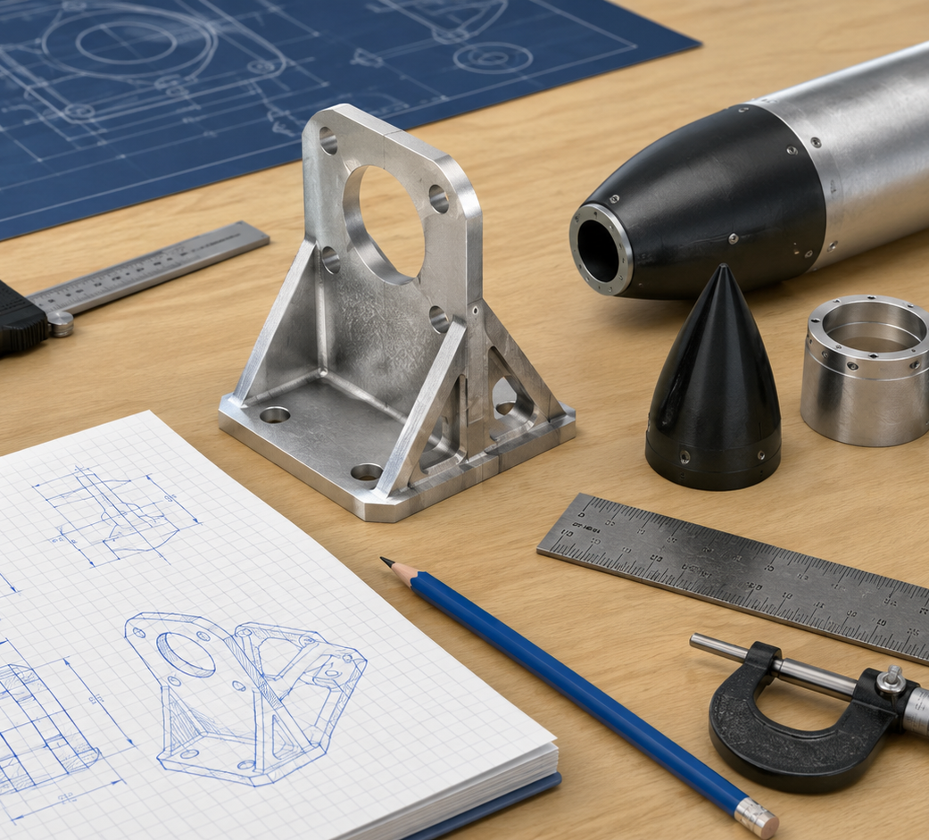
LOCKWOODSTEM
Lesson 1.1
Why Engineers Sketch
Big ideas you should understand before you start the work
Big Ideas
1
Engineering sketches are thinking tools, not art assignments.
2
A sketch captures design intent before time is spent building or modeling.
3
Good sketches make ideas easier to compare, discuss, and improve.
Ask yourself: What would someone else understand from my sketch or documentation?
LockwoodSTEM | Introduction to Engineering Design | Unit 1

Slide 7
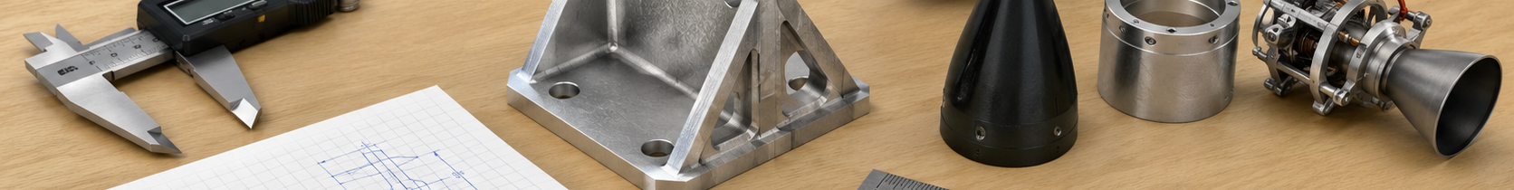
LOCKWOODSTEM
Lesson 1.1
Why Engineers Sketch
Use these moves while you work
Key Moves
Move | What it means
Capture the idea | Sketch the main form before details are added.
Label the function | Show what each feature is supposed to do.
Communicate intent | Use notes and arrows so another person understands the idea.
LockwoodSTEM | Introduction to Engineering Design | Unit 1

Slide 8
LOCKWOODSTEM
Lesson 1.1
Why Engineers Sketch
What you should have by the end of the lesson
Evidence Checklist
End-of-Lesson Product
□
Date and title the sketch page
A dated engineering sketch that communicates a design idea clearly enough for another person to understand.
□
Use light construction lines first
□
Add object lines and labels
□
Explain the design purpose in words
□
Save evidence in your notebook
Ask yourself: Could another student understand what I did today without me explaining it out loud?
LockwoodSTEM | Introduction to Engineering Design | Unit 1

Slide 9
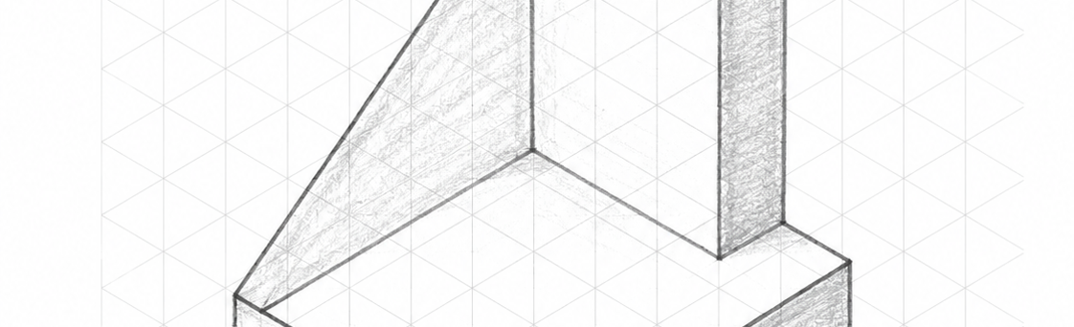
LOCKWOODSTEM
Lesson 1.2
Line Conventions
How do different types of lines help engineers communicate clearly?
Lesson 1.2
Line Conventions
Connect today’s work to your engineering notebook evidence.
LockwoodSTEM | Introduction to Engineering Design | Unit 1

Slide 10
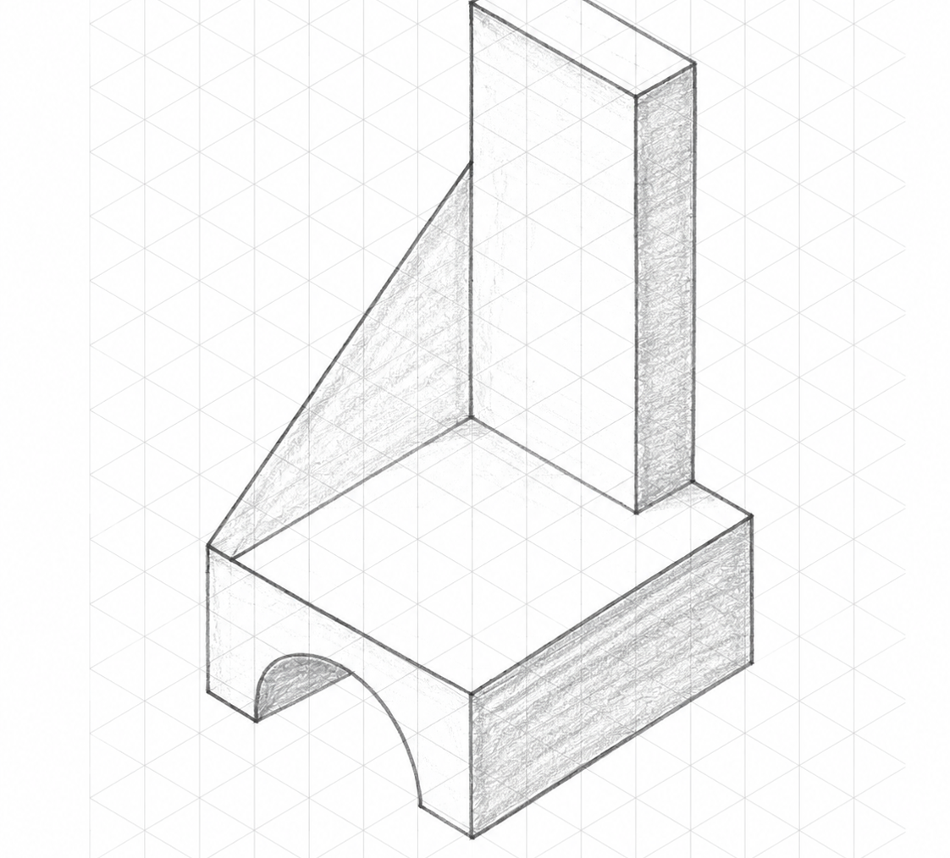
LOCKWOODSTEM
Lesson 1.2
Line Conventions
Big ideas you should understand before you start the work
Big Ideas
1
Line types are part of the language of engineering drawings.
2
Object, construction, hidden, center, and dimension lines each have a job.
3
Line weight helps readers tell planning marks from final design geometry.
Ask yourself: What would someone else understand from my sketch or documentation?
LockwoodSTEM | Introduction to Engineering Design | Unit 1

Slide 11

LOCKWOODSTEM
Lesson 1.2
Line Conventions
Use these moves while you work
Key Moves
Move | What it means
Construction lines | Use light lines to plan size, alignment, and spacing.
Object lines | Use dark lines for visible edges and final geometry.
Special lines | Use hidden, center, and dimension lines only when they add information.
LockwoodSTEM | Introduction to Engineering Design | Unit 1

Slide 12
LOCKWOODSTEM
Lesson 1.2
Line Conventions
What you should have by the end of the lesson
Evidence Checklist
End-of-Lesson Product
□
Practice at least three line types
A line convention practice sketch showing the correct purpose and appearance of major technical line types.
□
Label each line type
□
Use correct line weight
□
Apply lines to an aerospace-style part
□
Correct unclear or inconsistent lines
Ask yourself: Could another student understand what I did today without me explaining it out loud?
LockwoodSTEM | Introduction to Engineering Design | Unit 1

Slide 13
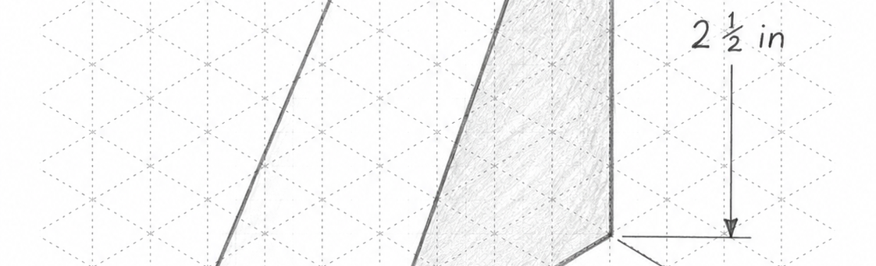
LOCKWOODSTEM
Lesson 1.3
Object Lines & Hidden Lines
How can a sketch show features that cannot be seen from one view?
Lesson 1.3
Object Lines & Hidden Lines
Connect today’s work to your engineering notebook evidence.
LockwoodSTEM | Introduction to Engineering Design | Unit 1

Slide 14
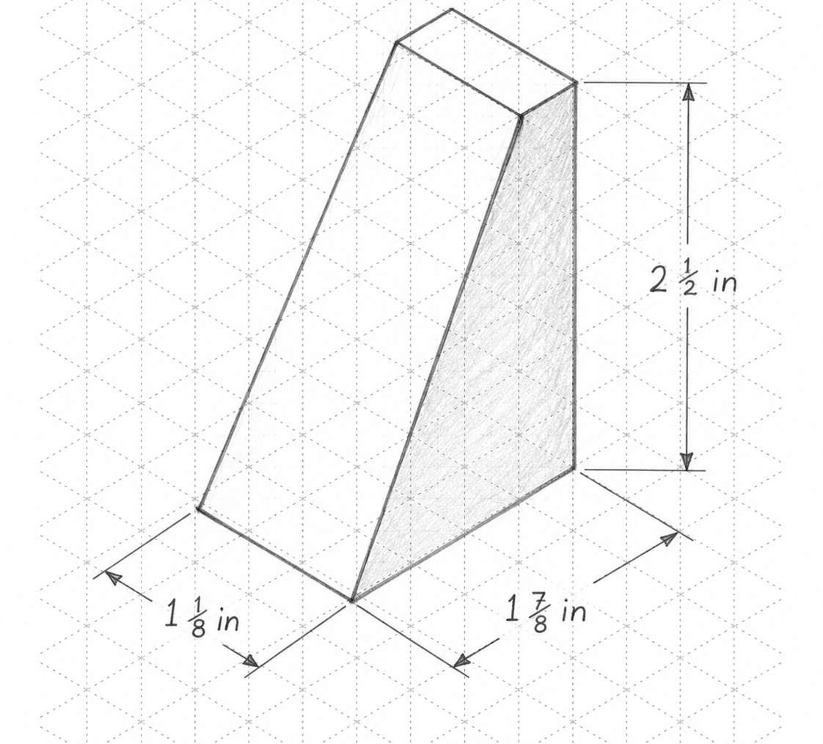
LOCKWOODSTEM
Lesson 1.3
Object Lines & Hidden Lines
Big ideas you should understand before you start the work
Big Ideas
1
Object lines show visible edges and surfaces.
2
Hidden lines show important internal or blocked features.
3
Hidden lines should clarify geometry, not clutter the view.
Ask yourself: What would someone else understand from my sketch or documentation?
LockwoodSTEM | Introduction to Engineering Design | Unit 1

Slide 15
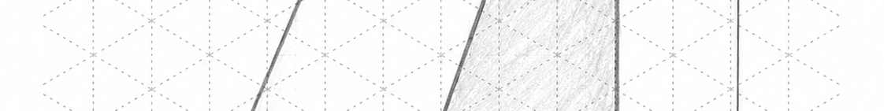
LOCKWOODSTEM
Lesson 1.3
Object Lines & Hidden Lines
Use these moves while you work
Key Moves
Move | What it means
Visible edges | Darken only the edges that can be seen from the chosen view.
Hidden features | Use short dashed lines for holes, slots, or edges behind surfaces.
Clean drawing | Avoid adding hidden lines unless they help the viewer understand the part.
LockwoodSTEM | Introduction to Engineering Design | Unit 1

Slide 16
LOCKWOODSTEM
Lesson 1.3
Object Lines & Hidden Lines
What you should have by the end of the lesson
Evidence Checklist
End-of-Lesson Product
□
Identify visible edges
A technical sketch using object and hidden lines to communicate visible and non-visible features.
□
Add hidden lines where needed
□
Keep hidden lines lighter than object lines
□
Explain what hidden features represent
□
Revise confusing sketches
Ask yourself: Could another student understand what I did today without me explaining it out loud?
LockwoodSTEM | Introduction to Engineering Design | Unit 1

Slide 17
LOCKWOODSTEM
Lesson 1.4
Centerlines & Symmetry
How do engineers show the center of a feature or object in a technical sketch?
Lesson 1.4
Centerlines & Symmetry
Connect today’s work to your engineering notebook evidence.
LockwoodSTEM | Introduction to Engineering Design | Unit 1

Slide 18
LOCKWOODSTEM
Lesson 1.4
Centerlines & Symmetry
Big ideas you should understand before you start the work
Big Ideas
1
Centerlines mark axes, centers, and symmetry.
2
Circular features and repeated patterns need center references.
3
Centerlines help parts align during modeling, fabrication, and inspection.
Ask yourself: What would someone else understand from my sketch or documentation?
LockwoodSTEM | Introduction to Engineering Design | Unit 1

Slide 19
LOCKWOODSTEM
Lesson 1.4
Centerlines & Symmetry
Use these moves while you work
Key Moves
Move | What it means
Find the center | Mark the center of holes, arcs, cylinders, or repeated features.
Show symmetry | Use centerlines to communicate that two sides mirror each other.
Support dimensions | Place dimensions from reliable center references when needed.
LockwoodSTEM | Introduction to Engineering Design | Unit 1

Slide 20
LOCKWOODSTEM
Lesson 1.4
Centerlines & Symmetry
What you should have by the end of the lesson
Evidence Checklist
End-of-Lesson Product
□
Add centerlines to holes or circular features
A sketch that uses centerlines to show hole centers, axes, or symmetry clearly.
□
Show symmetry where appropriate
□
Use centerlines consistently
□
Label alignment purpose
□
Check that centerlines do not look like object lines
Ask yourself: Could another student understand what I did today without me explaining it out loud?
LockwoodSTEM | Introduction to Engineering Design | Unit 1

Slide 21
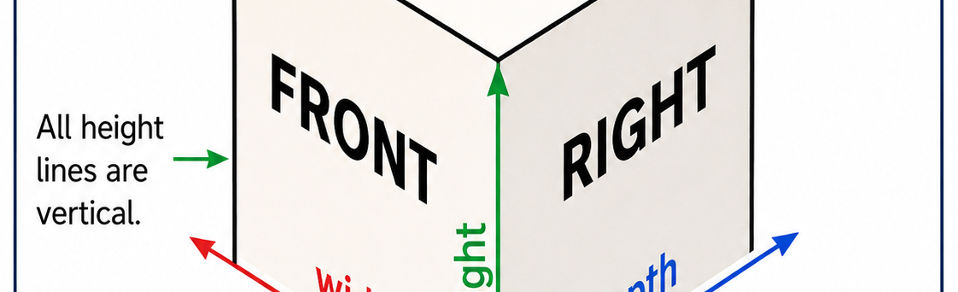
LOCKWOODSTEM
Lesson 1.5
Isometric Sketching
How can engineers show a 3D object clearly on a flat page?
Lesson 1.5
Isometric Sketching
Connect today’s work to your engineering notebook evidence.
LockwoodSTEM | Introduction to Engineering Design | Unit 1

Slide 22
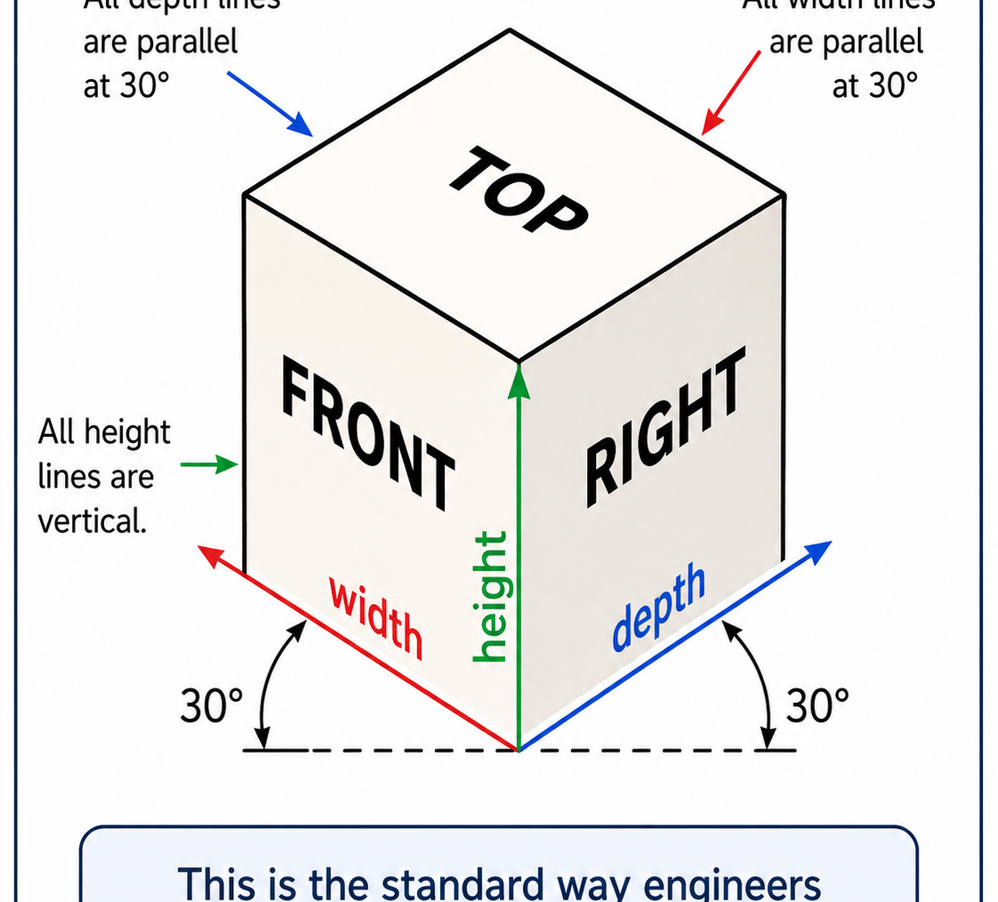
LOCKWOODSTEM
Lesson 1.5
Isometric Sketching
Big ideas you should understand before you start the work
Big Ideas
1
Isometric sketches show width, height, and depth at the same time.
2
Edges follow consistent vertical and angled directions.
3
Proportion and alignment matter more than artistic shading at first.
Ask yourself: What would someone else understand from my sketch or documentation?
LockwoodSTEM | Introduction to Engineering Design | Unit 1

Slide 23
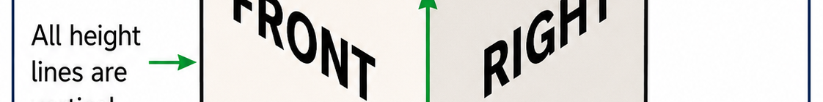
LOCKWOODSTEM
Lesson 1.5
Isometric Sketching
Use these moves while you work
Key Moves
Move | What it means
Start with a box | Build the object inside a simple width-height-depth envelope.
Follow axes | Keep vertical edges vertical and depth/width edges at consistent angles.
Add features | Place cuts, holes, and details after the main form is correct.
LockwoodSTEM | Introduction to Engineering Design | Unit 1

Slide 24
LOCKWOODSTEM
Lesson 1.5
Isometric Sketching
What you should have by the end of the lesson
Evidence Checklist
End-of-Lesson Product
□
Create an isometric box or envelope
A clean isometric sketch that communicates a 3D object using consistent axes and visible features.
□
Use consistent isometric axes
□
Add visible edges and features
□
Label the part or design intent
□
Check proportions before darkening lines
Ask yourself: Could another student understand what I did today without me explaining it out loud?
LockwoodSTEM | Introduction to Engineering Design | Unit 1

Slide 25
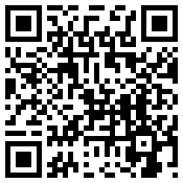
LOCKWOODSTEM
Lesson 1.5
Isometric Drawing Video Connection
Optional video connection
Video Connection
Isometric Drawing - Simplified
Scan or Open
Watch for:
• how the isometric axes are used
• how a 3D form starts from simple shapes
• how proportion and alignment guide the sketch
Open Video
https://www.youtube.com/watch?v=c_NRuzPs9R8
LockwoodSTEM | Introduction to Engineering Design | Unit 1

Slide 26
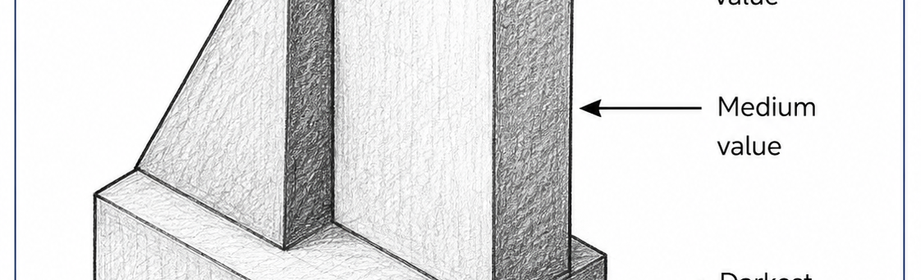
LOCKWOODSTEM
Lesson 1.6
Isometric Circles, Arcs, and Shading
How can engineers show curved features and surface depth in an isometric sketch?
Lesson 1.6
Isometric Circles, Arcs, and Shading
Connect today’s work to your engineering notebook evidence.
LockwoodSTEM | Introduction to Engineering Design | Unit 1

Slide 27
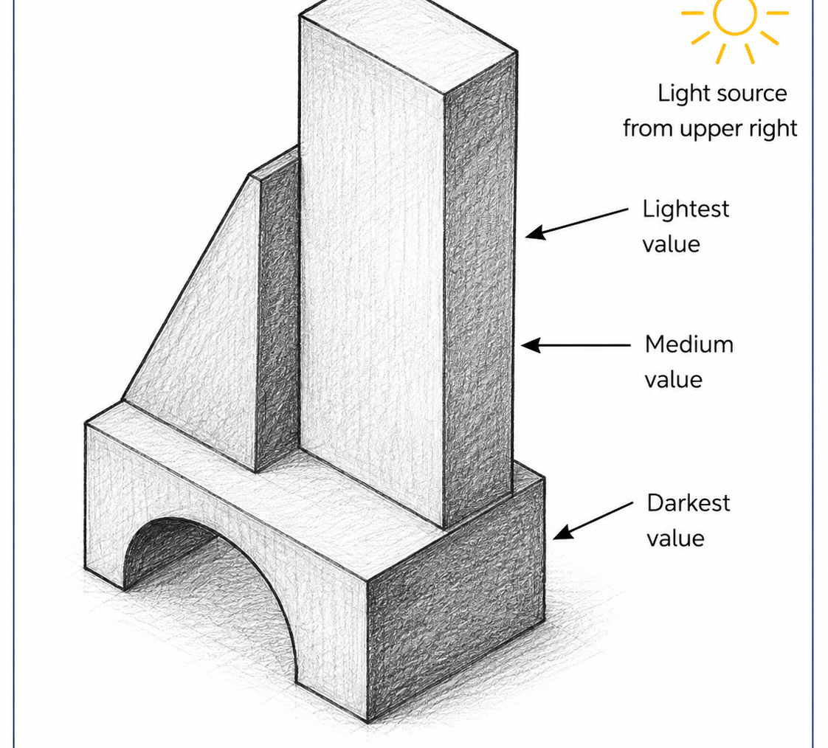
LOCKWOODSTEM
Lesson 1.6
Isometric Circles, Arcs, and Shading
Big ideas you should understand before you start the work
Big Ideas
1
Circles usually appear as ellipses in isometric view.
2
Curved features need careful placement so they still look attached to the part.
3
Shading and value can show surface direction, depth, and form.
Ask yourself: What would someone else understand from my sketch or documentation?
LockwoodSTEM | Introduction to Engineering Design | Unit 1

Slide 28
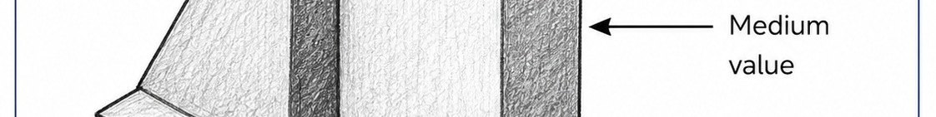
LOCKWOODSTEM
Lesson 1.6
Isometric Circles, Arcs, and Shading
Use these moves while you work
Key Moves
Move | What it means
Curved features | Sketch circles, holes, and arcs as ellipses that follow the surface.
Surface value | Use light, medium, and dark values to show different faces.
Clarity first | Use shading to support the sketch, not hide weak geometry.
LockwoodSTEM | Introduction to Engineering Design | Unit 1

Slide 29
LOCKWOODSTEM
Lesson 1.6
Isometric Circles, Arcs, and Shading
What you should have by the end of the lesson
Evidence Checklist
End-of-Lesson Product
□
Practice at least one curved feature
An isometric sketch with at least one curved feature and shading that improves form clarity.
□
Use a light-to-dark value scale
□
Add shading to show form
□
Keep object edges readable
□
Explain what the curved feature represents
Ask yourself: Could another student understand what I did today without me explaining it out loud?
LockwoodSTEM | Introduction to Engineering Design | Unit 1

Slide 30
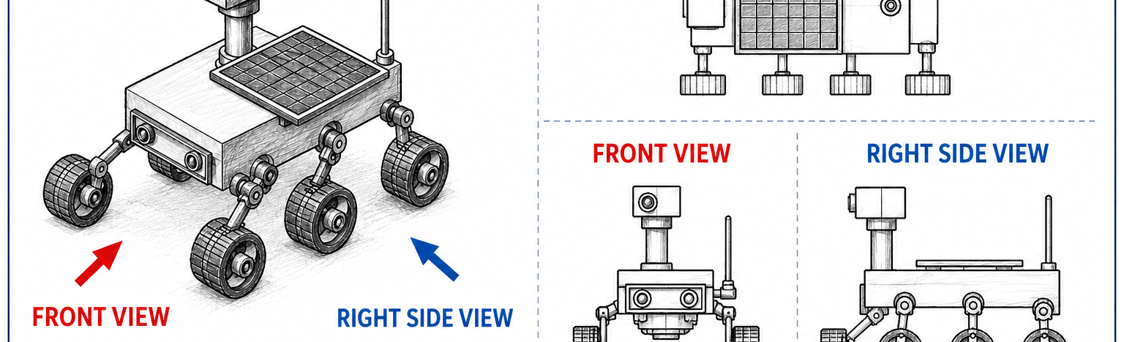
LOCKWOODSTEM
Lesson 1.7
Orthographic Projection
Why do engineers use multiple 2D views instead of only one 3D sketch?
Lesson 1.7
Orthographic Projection
Connect today’s work to your engineering notebook evidence.
LockwoodSTEM | Introduction to Engineering Design | Unit 1

Slide 31
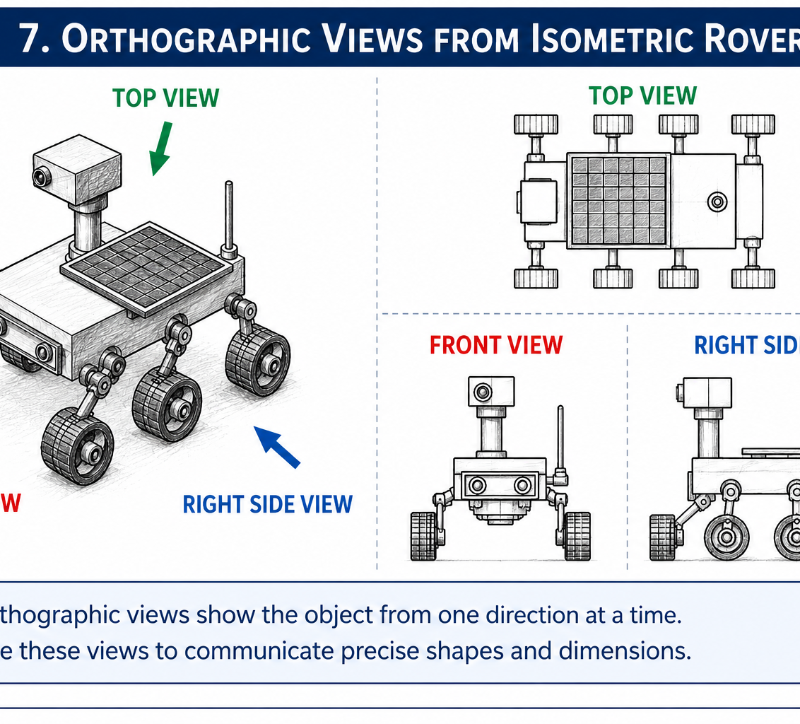
LOCKWOODSTEM
Lesson 1.7
Orthographic Projection
Big ideas you should understand before you start the work
Big Ideas
1
Orthographic projection shows a 3D object as multiple flat views.
2
Each view shows only two dimensions at a time.
3
Multiple views reduce guessing when shape, size, or hidden features matter.
Ask yourself: What would someone else understand from my sketch or documentation?
LockwoodSTEM | Introduction to Engineering Design | Unit 1

Slide 32
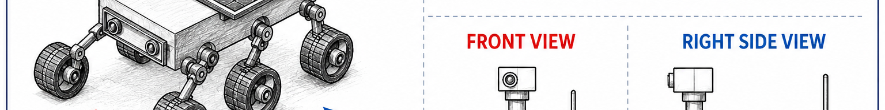
LOCKWOODSTEM
Lesson 1.7
Orthographic Projection
Use these moves while you work
Key Moves
Move | What it means
Choose views | Use front, top, and right-side views to show the important features.
Align views | Keep matching widths, heights, and depths lined up.
Compare with 3D | Use the isometric view to check if each 2D view makes sense.
LockwoodSTEM | Introduction to Engineering Design | Unit 1

Slide 33
LOCKWOODSTEM
Lesson 1.7
Orthographic Projection
What you should have by the end of the lesson
Evidence Checklist
End-of-Lesson Product
□
Identify front, top, and right views
A basic orthographic layout that shows front, top, and right-side views of the same object.
□
Align the views correctly
□
Show matching features across views
□
Use hidden lines if needed
□
Check the views against the 3D object
Ask yourself: Could another student understand what I did today without me explaining it out loud?
LockwoodSTEM | Introduction to Engineering Design | Unit 1

Slide 34
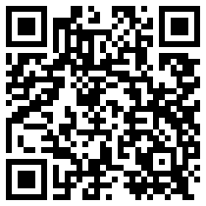
LOCKWOODSTEM
Lesson 1.7
Orthographic Projection Video Connection
Optional video connection
Video Connection
Beginning Orthographic Projection
Scan or Open
Watch for:
• how front, top, and side views relate
• how 3D features become 2D views
• how alignment keeps views accurate
Open Video
https://www.youtube.com/watch?v=ytwEDvX-l44
LockwoodSTEM | Introduction to Engineering Design | Unit 1

Slide 35
LOCKWOODSTEM
Lesson 1.8
Top, Front & Right Side Views
How do engineers keep multiple views of the same object organized and accurate?
Lesson 1.8
Top, Front & Right Side Views
Connect today’s work to your engineering notebook evidence.
LockwoodSTEM | Introduction to Engineering Design | Unit 1

Slide 36
LOCKWOODSTEM
Lesson 1.8
Top, Front & Right Side Views
Big ideas you should understand before you start the work
Big Ideas
1
View placement is standardized so drawings are easy to read.
2
The front view anchors the drawing layout.
3
Matching dimensions must align across related views.
Ask yourself: What would someone else understand from my sketch or documentation?
LockwoodSTEM | Introduction to Engineering Design | Unit 1

Slide 37
LOCKWOODSTEM
Lesson 1.8
Top, Front & Right Side Views
Use these moves while you work
Key Moves
Move | What it means
Front view | Choose the view that best shows the part shape and function.
Top view | Place it directly above the front view and keep widths aligned.
Right view | Place it directly to the right and keep heights aligned.
LockwoodSTEM | Introduction to Engineering Design | Unit 1

Slide 38
LOCKWOODSTEM
Lesson 1.8
Top, Front & Right Side Views
What you should have by the end of the lesson
Evidence Checklist
End-of-Lesson Product
□
Choose the best front view
A multiview sketch with correctly placed and aligned front, top, and right-side views.
□
Place top and right views correctly
□
Project matching edges across views
□
Keep spacing neat and readable
□
Label views if needed
Ask yourself: Could another student understand what I did today without me explaining it out loud?
LockwoodSTEM | Introduction to Engineering Design | Unit 1

Slide 39
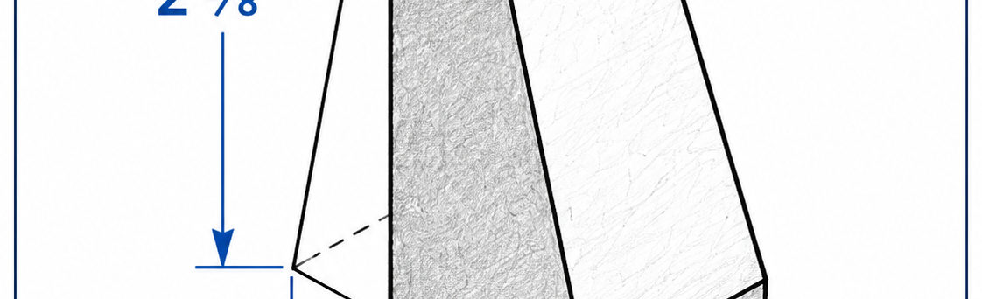
LOCKWOODSTEM
Lesson 1.9
Dimensioning Basics
How do engineers show the size of an object clearly in a drawing?
Lesson 1.9
Dimensioning Basics
Connect today’s work to your engineering notebook evidence.
LockwoodSTEM | Introduction to Engineering Design | Unit 1

Slide 40
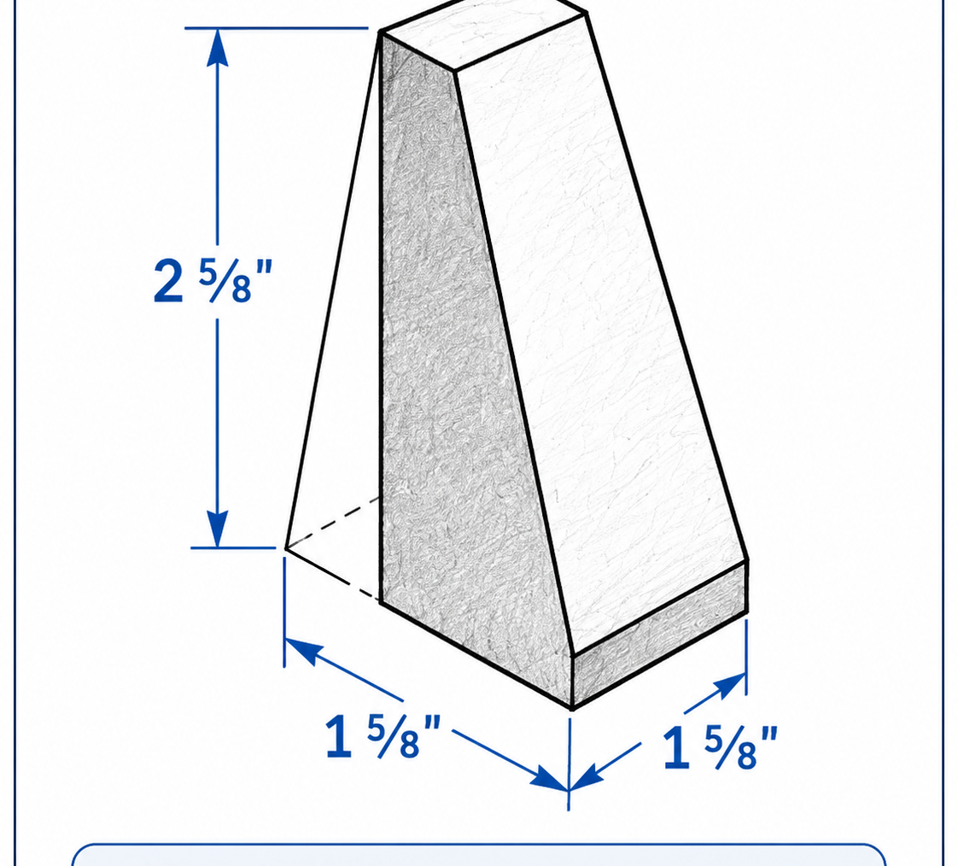
LOCKWOODSTEM
Lesson 1.9
Dimensioning Basics
Big ideas you should understand before you start the work
Big Ideas
1
Views show shape, but dimensions show size.
2
Dimension lines, extension lines, arrows, and numbers work together.
3
Good dimensioning avoids missing, repeated, or confusing measurements.
Ask yourself: What would someone else understand from my sketch or documentation?
LockwoodSTEM | Introduction to Engineering Design | Unit 1

Slide 41

LOCKWOODSTEM
Lesson 1.9
Dimensioning Basics
Use these moves while you work
Key Moves
Move | What it means
Dimension lines | Show the distance being measured with arrowheads.
Extension lines | Connect the measurement to the feature without touching the object line.
Readable values | Place numbers clearly and include units when required.
LockwoodSTEM | Introduction to Engineering Design | Unit 1

Slide 42
LOCKWOODSTEM
Lesson 1.9
Dimensioning Basics
What you should have by the end of the lesson
Evidence Checklist
End-of-Lesson Product
□
Add overall size dimensions
A dimensioned technical sketch that communicates the size and important feature locations of a part.
□
Add feature location dimensions
□
Use extension and dimension lines correctly
□
Avoid duplicate dimensions
□
Check that someone could model the part from your drawing
Ask yourself: Could another student understand what I did today without me explaining it out loud?
LockwoodSTEM | Introduction to Engineering Design | Unit 1

Slide 43
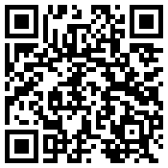
LOCKWOODSTEM
Lesson 1.9
Dimensioning Video Connection
Optional video connection
Video Connection
Engineering Drawing Dimensioning: The Basics Explained
Scan or Open
Watch for:
• how dimensions communicate size
• how extension and dimension lines work
• why drawings should avoid missing or duplicate dimensions
Open Video
https://www.youtube.com/watch?v=Q9kOFtUltqM
LockwoodSTEM | Introduction to Engineering Design | Unit 1

Slide 44
LOCKWOODSTEM
Lesson 1.10
Aerospace Bracket Sketch
How can sketches communicate the shape, features, and size of a part before it is modeled or built?
Lesson 1.10
Aerospace Bracket Sketch
Connect today’s work to your engineering notebook evidence.
LockwoodSTEM | Introduction to Engineering Design | Unit 1

Slide 45
LOCKWOODSTEM
Lesson 1.10
Aerospace Bracket Sketch
Big ideas you should understand before you start the work
Big Ideas
1
A bracket holds, supports, connects, or aligns other parts.
2
Aerospace brackets often balance strength, light weight, mounting holes, and clearances.
3
A technical sketch should show form, features, and dimensions together.
Ask yourself: What would someone else understand from my sketch or documentation?
LockwoodSTEM | Introduction to Engineering Design | Unit 1

Slide 46
LOCKWOODSTEM
Lesson 1.10
Aerospace Bracket Sketch
Use these moves while you work
Key Moves
Move | What it means
Study the part | Identify holes, supports, cutouts, ribs, and mounting features.
Sketch the form | Use isometric or multiview sketches to show shape clearly.
Add dimensions | Dimension key features needed for CAD or fabrication.
LockwoodSTEM | Introduction to Engineering Design | Unit 1

Slide 47
LOCKWOODSTEM
Lesson 1.10
Aerospace Bracket Sketch
What you should have by the end of the lesson
Evidence Checklist
End-of-Lesson Product
□
Create a bracket sketch
A clear aerospace bracket sketch with labels, dimensions, and line conventions.
□
Label major features
□
Include important dimensions
□
Use line conventions accurately
□
Explain the bracket function
Ask yourself: Could another student understand what I did today without me explaining it out loud?
LockwoodSTEM | Introduction to Engineering Design | Unit 1

Slide 48

LOCKWOODSTEM
Lesson 1.11
Rocket Assembly Reverse Engineering
How can engineers learn from an existing rocket assembly by carefully taking it apart?
Lesson 1.11
Rocket Assembly Reverse Engineering
Connect today’s work to your engineering notebook evidence.
LockwoodSTEM | Introduction to Engineering Design | Unit 1

Slide 49
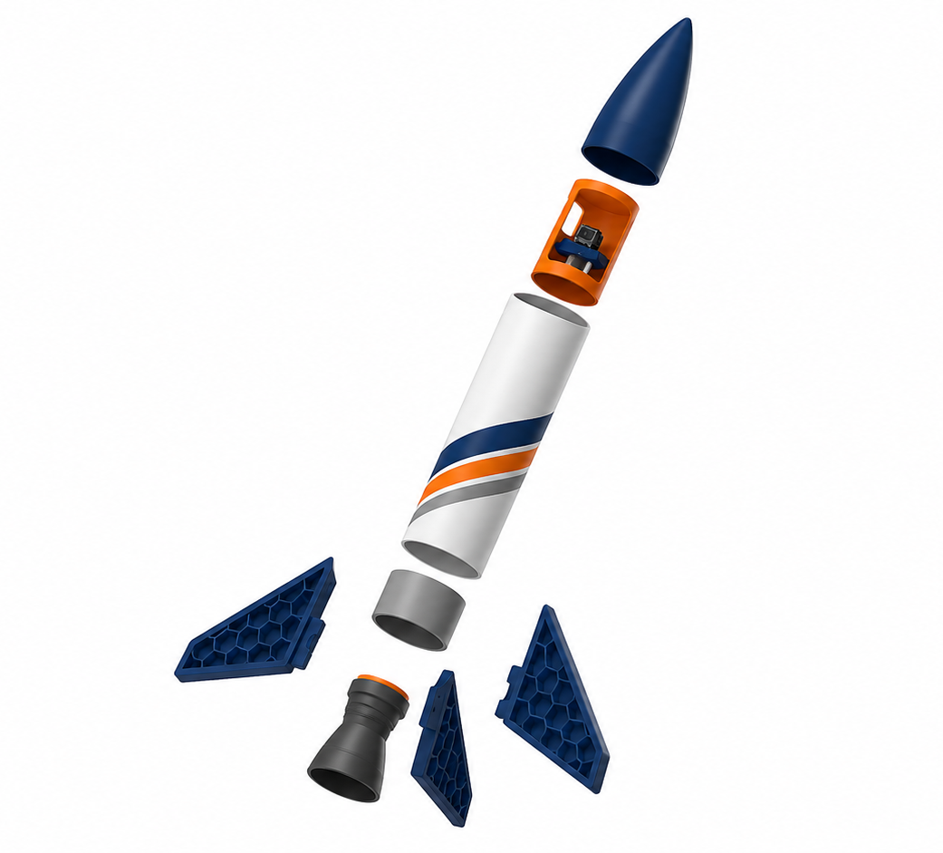
LOCKWOODSTEM
Lesson 1.11
Rocket Assembly Reverse Engineering
Big ideas you should understand before you start the work
Big Ideas
1
Reverse engineering means studying an existing product to understand how it works.
2
Each rocket part has a function, fit, and relationship to other parts.
3
Careful disassembly protects evidence and makes reassembly possible.
Ask yourself: What would someone else understand from my sketch or documentation?
LockwoodSTEM | Introduction to Engineering Design | Unit 1

Slide 50

LOCKWOODSTEM
Lesson 1.11
Rocket Assembly Reverse Engineering
Use these moves while you work
Key Moves
Move | What it means
Observe first | Record the assembled rocket before removing parts.
Disassemble carefully | Separate parts without damaging connections or losing orientation.
Document fits | Note where parts slide, press, align, or connect.
LockwoodSTEM | Introduction to Engineering Design | Unit 1

Slide 51
LOCKWOODSTEM
Lesson 1.11
Rocket Assembly Reverse Engineering
What you should have by the end of the lesson
Evidence Checklist
End-of-Lesson Product
□
Photograph or sketch the assembled rocket
A reverse-engineering notebook entry showing rocket parts, functions, fits, and initial observations.
□
List major parts
□
Record how parts connect
□
Note any fit or alignment issues
□
Keep parts organized for reassembly
Ask yourself: Could another student understand what I did today without me explaining it out loud?
LockwoodSTEM | Introduction to Engineering Design | Unit 1

Slide 52
LOCKWOODSTEM
Lesson 1.12
Why Documentation Matters
Why is a design not finished when the sketch or model is finished?
Lesson 1.12
Why Documentation Matters
Connect today’s work to your engineering notebook evidence.
LockwoodSTEM | Introduction to Engineering Design | Unit 1

Slide 53
LOCKWOODSTEM
Lesson 1.12
Why Documentation Matters
Big ideas you should understand before you start the work
Big Ideas
1
Documentation explains what the design is, how it works, and how it was built.
2
Good documentation makes work repeatable and inspectable.
3
Missing notes make future design decisions harder to justify.
Ask yourself: What would someone else understand from my sketch or documentation?
LockwoodSTEM | Introduction to Engineering Design | Unit 1

Slide 54
LOCKWOODSTEM
Lesson 1.12
Why Documentation Matters
Use these moves while you work
Key Moves
Move | What it means
Record context | Explain what the part or assembly is supposed to do.
Record evidence | Include sketches, measurements, photos, and observations.
Record decisions | Explain why a design choice or revision makes sense.
LockwoodSTEM | Introduction to Engineering Design | Unit 1

Slide 55
LOCKWOODSTEM
Lesson 1.12
Why Documentation Matters
What you should have by the end of the lesson
Evidence Checklist
End-of-Lesson Product
□
Add clear titles and dates
A documentation update that makes the rocket assembly understandable without verbal explanation.
□
Use labels and captions
□
Record part names and functions
□
Explain connection methods
□
Identify what evidence is still missing
Ask yourself: Could another student understand what I did today without me explaining it out loud?
LockwoodSTEM | Introduction to Engineering Design | Unit 1

Slide 56
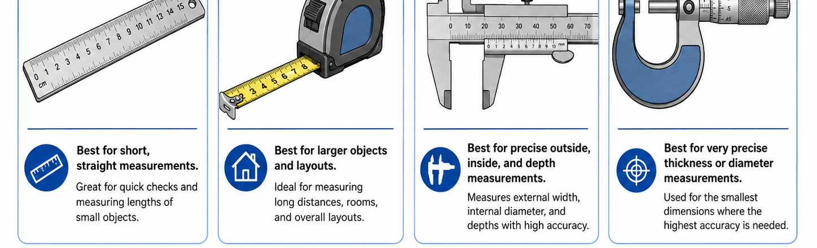
LOCKWOODSTEM
Lesson 1.13
Measurement Tools
How do engineers choose the right tool for accurate measurement?
Lesson 1.13
Measurement Tools
Connect today’s work to your engineering notebook evidence.
LockwoodSTEM | Introduction to Engineering Design | Unit 1

Slide 57
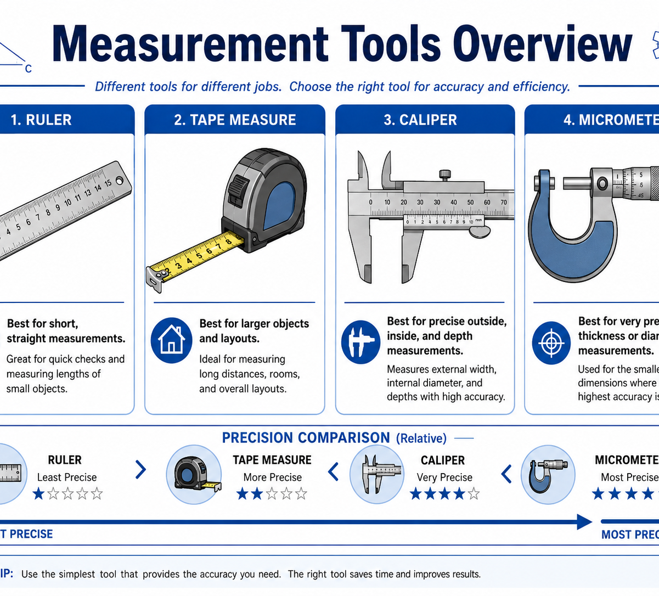
LOCKWOODSTEM
Lesson 1.13
Measurement Tools
Big ideas you should understand before you start the work
Big Ideas
1
Different measurement tools are accurate for different tasks.
2
A measurement is only useful if the tool, units, and method are clear.
3
Repeated measurements help identify mistakes or variation.
Ask yourself: What would someone else understand from my sketch or documentation?
LockwoodSTEM | Introduction to Engineering Design | Unit 1

Slide 58
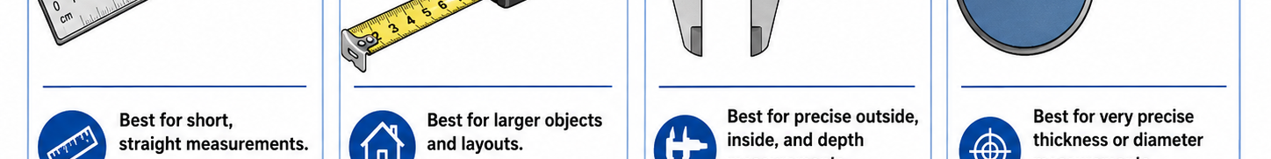
LOCKWOODSTEM
Lesson 1.13
Measurement Tools
Use these moves while you work
Key Moves
Move | What it means
Ruler / tape | Use for overall lengths and rough layout.
Calipers | Use for inside, outside, depth, and step measurements.
Micrometer | Use for precise thickness or diameter when needed.
LockwoodSTEM | Introduction to Engineering Design | Unit 1

Slide 59
LOCKWOODSTEM
Lesson 1.13
Measurement Tools
What you should have by the end of the lesson
Evidence Checklist
End-of-Lesson Product
□
Choose the correct measuring tool
A measurement table for rocket parts that includes tool choice, units, and repeated measurements.
□
Record units and tool used
□
Take repeated measurements
□
Measure at least one critical rocket feature
□
Note uncertainty or variation
Ask yourself: Could another student understand what I did today without me explaining it out loud?
LockwoodSTEM | Introduction to Engineering Design | Unit 1

Slide 60
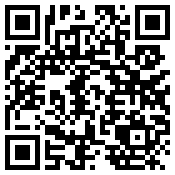
LOCKWOODSTEM
Lesson 1.13
Measurement Tools Video Connection
Optional video connection
Video Connection
How to Properly Use Calipers
Scan or Open
Watch for:
• outside, inside, and depth measurements
• why the tool should be zeroed
• how to avoid squeezing or tilting the jaws
Open Video
https://www.youtube.com/watch?v=pIy3pIn53Ls
LockwoodSTEM | Introduction to Engineering Design | Unit 1

Slide 61
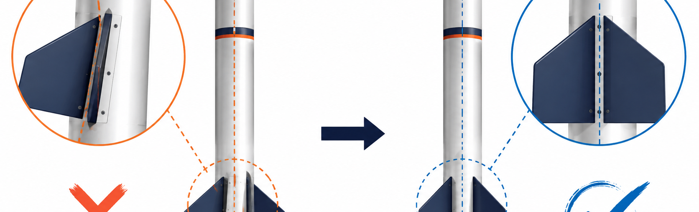
LOCKWOODSTEM
Lesson 1.14
Tolerances
Why do engineers allow some variation in measurements, but not too much?
Lesson 1.14
Tolerances
Connect today’s work to your engineering notebook evidence.
LockwoodSTEM | Introduction to Engineering Design | Unit 1

Slide 62
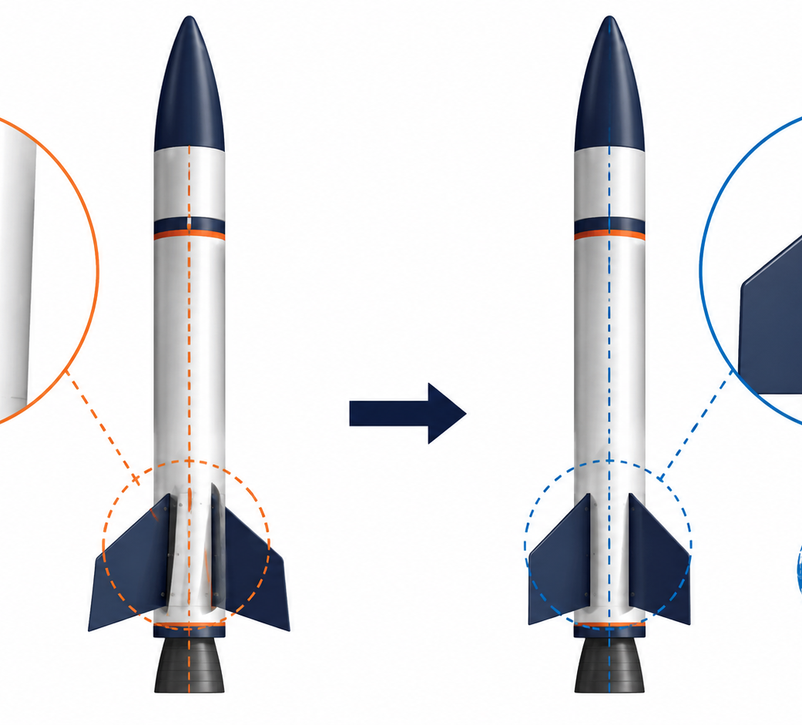
LOCKWOODSTEM
Lesson 1.14
Tolerances
Big ideas you should understand before you start the work
Big Ideas
1
A target dimension is the intended size of a feature.
2
Tolerance is the allowed variation around that target.
3
Fit decisions depend on whether variation still allows the assembly to work.
Ask yourself: What would someone else understand from my sketch or documentation?
LockwoodSTEM | Introduction to Engineering Design | Unit 1

Slide 63

LOCKWOODSTEM
Lesson 1.14
Tolerances
Use these moves while you work
Key Moves
Move | What it means
Target value | Identify the intended size or fit.
Acceptable range | Set upper and lower limits that still allow function.
Fit decision | Decide pass, adjust, or redesign based on evidence.
LockwoodSTEM | Introduction to Engineering Design | Unit 1

Slide 64
LOCKWOODSTEM
Lesson 1.14
Tolerances
What you should have by the end of the lesson
Evidence Checklist
End-of-Lesson Product
□
Identify one target dimension
A tolerance analysis showing whether a rocket part fit is acceptable, too loose, or too tight.
□
Create an acceptable tolerance range
□
Compare measured values to the range
□
Classify the fit result
□
Explain what should change if the fit fails
Ask yourself: Could another student understand what I did today without me explaining it out loud?
LockwoodSTEM | Introduction to Engineering Design | Unit 1

Slide 65
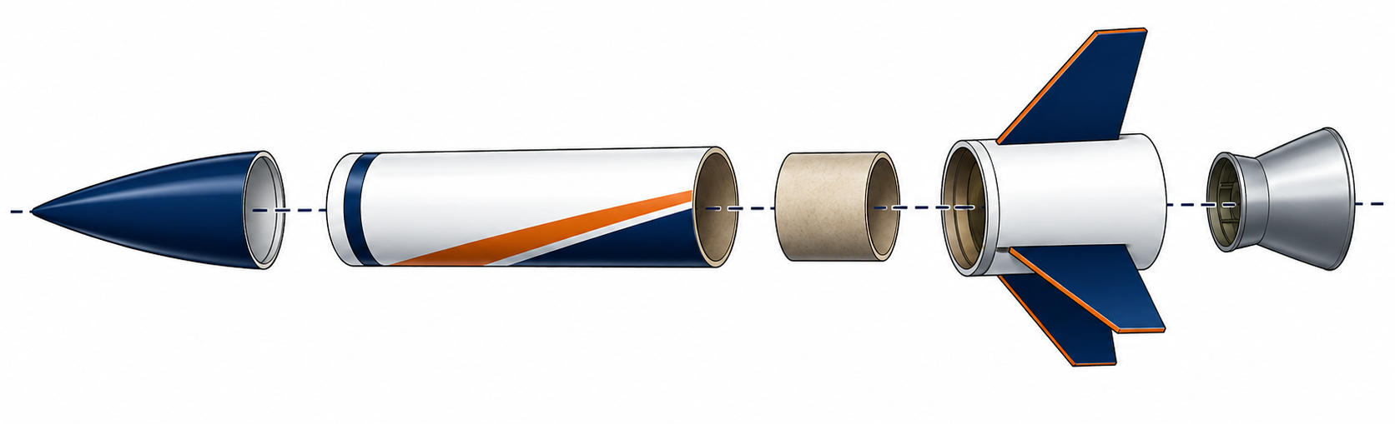
LOCKWOODSTEM
Lesson 1.15
Adhesives & Fasteners
How do engineers decide the best way to connect parts together?
Lesson 1.15
Adhesives & Fasteners
Connect today’s work to your engineering notebook evidence.
LockwoodSTEM | Introduction to Engineering Design | Unit 1

Slide 66
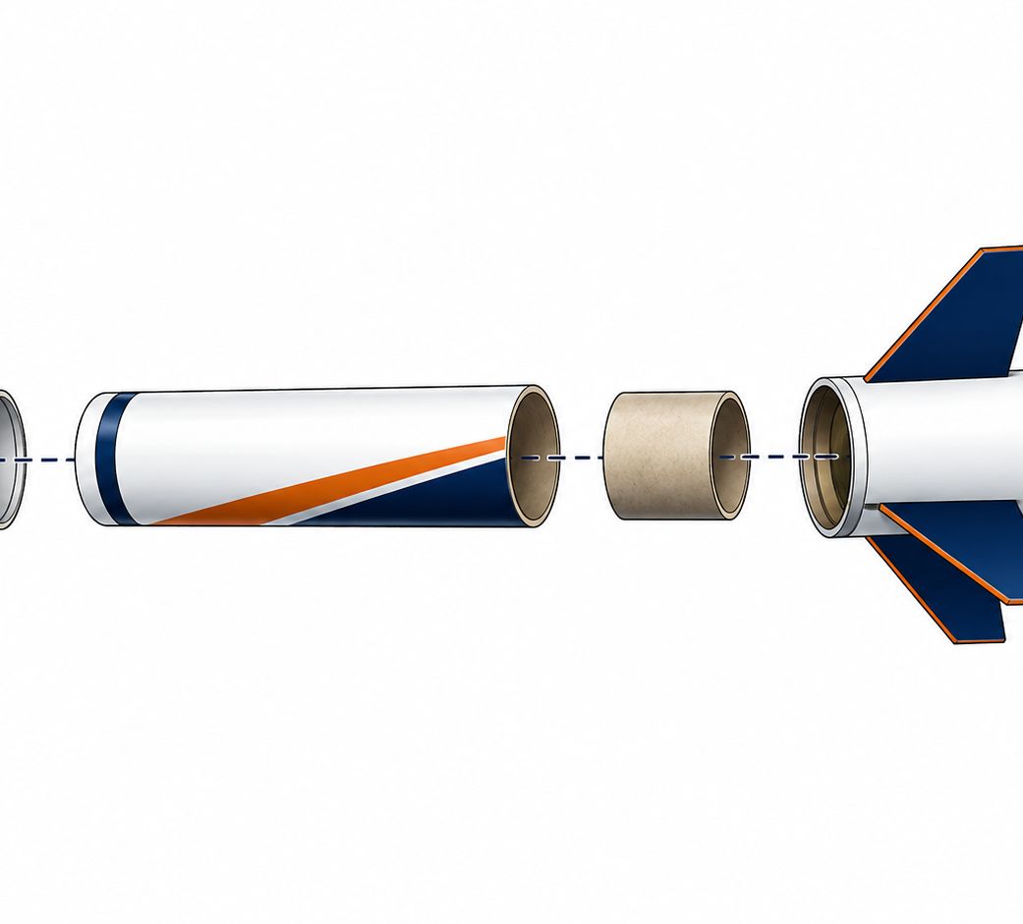
LOCKWOODSTEM
Lesson 1.15
Adhesives & Fasteners
Big ideas you should understand before you start the work
Big Ideas
1
Connections can be permanent, removable, adjustable, or temporary.
2
Adhesives can be quick but may make disassembly difficult.
3
Fasteners and fit-based features can support inspection, repair, and revision.
Ask yourself: What would someone else understand from my sketch or documentation?
LockwoodSTEM | Introduction to Engineering Design | Unit 1

Slide 67
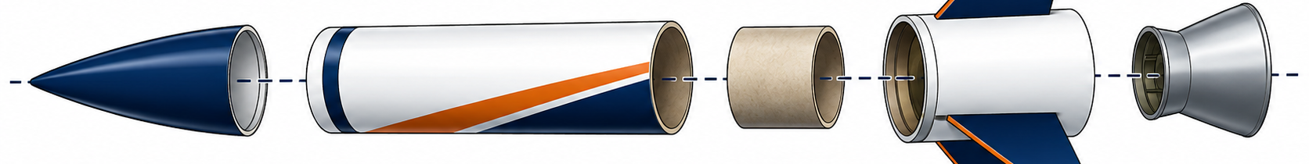
LOCKWOODSTEM
Lesson 1.15
Adhesives & Fasteners
Use these moves while you work
Key Moves
Move | What it means
Choose connection purpose | Decide if the part must be removed later.
Match method to load | Consider strength, alignment, and expected forces.
Document the method | Record whether the connection slides, snaps, presses, glues, or fastens.
LockwoodSTEM | Introduction to Engineering Design | Unit 1

Slide 68
LOCKWOODSTEM
Lesson 1.15
Adhesives & Fasteners
What you should have by the end of the lesson
Evidence Checklist
End-of-Lesson Product
□
Identify rocket connection points
A connection method table for the rocket assembly that explains how parts attach and why.
□
Classify each connection method
□
Decide removable vs. permanent
□
Explain one connection trade-off
□
Update assembly notes
Ask yourself: Could another student understand what I did today without me explaining it out loud?
LockwoodSTEM | Introduction to Engineering Design | Unit 1

Slide 69
LOCKWOODSTEM
Lesson 1.16
Rocket Assembly Systems
How do multiple rocket parts work together as one assembly?
Lesson 1.16
Rocket Assembly Systems
Connect today’s work to your engineering notebook evidence.
LockwoodSTEM | Introduction to Engineering Design | Unit 1

Slide 70
LOCKWOODSTEM
Lesson 1.16
Rocket Assembly Systems
Big ideas you should understand before you start the work
Big Ideas
1
A part is one individual component of a larger design.
2
A subassembly is a smaller group of parts that work together.
3
The full assembly depends on alignment, fit, order, and function.
Ask yourself: What would someone else understand from my sketch or documentation?
LockwoodSTEM | Introduction to Engineering Design | Unit 1

Slide 71
LOCKWOODSTEM
Lesson 1.16
Rocket Assembly Systems
Use these moves while you work
Key Moves
Move | What it means
Part names | Use consistent names for each component.
Subassemblies | Group related parts such as fin section, payload bay, or nose section.
System function | Explain how the parts work together as one rocket assembly.
LockwoodSTEM | Introduction to Engineering Design | Unit 1

Slide 72
LOCKWOODSTEM
Lesson 1.16
Rocket Assembly Systems
What you should have by the end of the lesson
Evidence Checklist
End-of-Lesson Product
□
Identify all major rocket parts
A rocket system map showing parts, subassemblies, connection points, and functions.
□
Group parts into subassemblies
□
Describe the function of each part
□
Mark connection points
□
Explain the full assembly purpose
Ask yourself: Could another student understand what I did today without me explaining it out loud?
LockwoodSTEM | Introduction to Engineering Design | Unit 1

Slide 73
LOCKWOODSTEM
Lesson 1.17
Documenting the Rocket Assembly
What information does someone need to understand or recreate the rocket assembly?
Lesson 1.17
Documenting the Rocket Assembly
Connect today’s work to your engineering notebook evidence.
LockwoodSTEM | Introduction to Engineering Design | Unit 1

Slide 74
LOCKWOODSTEM
Lesson 1.17
Documenting the Rocket Assembly
Big ideas you should understand before you start the work
Big Ideas
1
Assembly documentation combines labeled sketches, part names, materials, and connection notes.
2
The goal is clarity for a future builder or reviewer.
3
Photos and sketches should be labeled with what they prove.
Ask yourself: What would someone else understand from my sketch or documentation?
LockwoodSTEM | Introduction to Engineering Design | Unit 1

Slide 75
LOCKWOODSTEM
Lesson 1.17
Documenting the Rocket Assembly
Use these moves while you work
Key Moves
Move | What it means
Assembly sketch | Show the rocket assembled with labeled parts.
Parts list | Name each part and record quantity/material notes.
Connection notes | Explain how each part fits, aligns, or attaches.
LockwoodSTEM | Introduction to Engineering Design | Unit 1

Slide 76
LOCKWOODSTEM
Lesson 1.17
Documenting the Rocket Assembly
What you should have by the end of the lesson
Evidence Checklist
End-of-Lesson Product
□
Create a labeled assembly sketch
A labeled rocket assembly documentation page that explains parts, connections, materials, and purpose.
□
Add a clear parts list
□
Write connection notes
□
Include material or fabrication notes
□
Identify missing documentation
Ask yourself: Could another student understand what I did today without me explaining it out loud?
LockwoodSTEM | Introduction to Engineering Design | Unit 1

Slide 77
LOCKWOODSTEM
Lesson 1.18
Rocket Exploded View
How can engineers show rocket parts separated without losing how they fit together?
Lesson 1.18
Rocket Exploded View
Connect today’s work to your engineering notebook evidence.
LockwoodSTEM | Introduction to Engineering Design | Unit 1

Slide 78
LOCKWOODSTEM
Lesson 1.18
Rocket Exploded View
Big ideas you should understand before you start the work
Big Ideas
1
An exploded view separates parts so each component can be seen.
2
Alignment should still show where parts belong in the assembly.
3
Exploded views can communicate assembly order and fit relationships.
Ask yourself: What would someone else understand from my sketch or documentation?
LockwoodSTEM | Introduction to Engineering Design | Unit 1

Slide 79
LOCKWOODSTEM
Lesson 1.18
Rocket Exploded View
Use these moves while you work
Key Moves
Move | What it means
Separate along axis | Move parts away from the assembly without changing orientation.
Show alignment | Keep parts visually lined up with where they fit.
Add labels | Use part names, callouts, or item numbers for clarity.
LockwoodSTEM | Introduction to Engineering Design | Unit 1

Slide 80
LOCKWOODSTEM
Lesson 1.18
Rocket Exploded View
What you should have by the end of the lesson
Evidence Checklist
End-of-Lesson Product
□
Create a rocket exploded view
A rocket exploded view showing separated parts, alignment, and clear part labels.
□
Keep parts aligned
□
Label each part clearly
□
Show assembly order if possible
□
Connect view to BOM item names
Ask yourself: Could another student understand what I did today without me explaining it out loud?
LockwoodSTEM | Introduction to Engineering Design | Unit 1

Slide 81
LOCKWOODSTEM
Lesson 1.19
Rocket Bill of Materials
How do engineers keep track of every part needed to build an assembly?
Lesson 1.19
Rocket Bill of Materials
Connect today’s work to your engineering notebook evidence.
LockwoodSTEM | Introduction to Engineering Design | Unit 1

Slide 82
LOCKWOODSTEM
Lesson 1.19
Rocket Bill of Materials
Big ideas you should understand before you start the work
Big Ideas
1
A Bill of Materials is a structured list of all parts in an assembly.
2
Quantities must match the actual number of parts used.
3
Notes can explain materials, connections, or special features.
Ask yourself: What would someone else understand from my sketch or documentation?
LockwoodSTEM | Introduction to Engineering Design | Unit 1

Slide 83
LOCKWOODSTEM
Lesson 1.19
Rocket Bill of Materials
Use these moves while you work
Key Moves
Move | What it means
Item number | Give each part a consistent number or name.
Quantity | Count repeated parts such as fins, rings, or fasteners accurately.
Notes | Record materials, fit type, or special assembly details.
LockwoodSTEM | Introduction to Engineering Design | Unit 1

Slide 84
LOCKWOODSTEM
Lesson 1.19
Rocket Bill of Materials
What you should have by the end of the lesson
Evidence Checklist
End-of-Lesson Product
□
List every rocket part
A complete rocket Bill of Materials that matches the exploded view and assembly notes.
□
Record quantity for each item
□
Add material or fabrication notes
□
Match item names to exploded view labels
□
Check for missing repeated parts
Ask yourself: Could another student understand what I did today without me explaining it out loud?
LockwoodSTEM | Introduction to Engineering Design | Unit 1

Slide 85
LOCKWOODSTEM
Lesson 1.20
Rocket Assembly Notes
How do engineers write reassembly instructions that another team can follow?
Lesson 1.20
Rocket Assembly Notes
Connect today’s work to your engineering notebook evidence.
LockwoodSTEM | Introduction to Engineering Design | Unit 1

Slide 86
LOCKWOODSTEM
Lesson 1.20
Rocket Assembly Notes
Big ideas you should understand before you start the work
Big Ideas
1
Assembly notes explain order, alignment, fit, and cautions.
2
Good instructions reduce mistakes during rebuilding.
3
Notes should include checks that confirm a step was done correctly.
Ask yourself: What would someone else understand from my sketch or documentation?
LockwoodSTEM | Introduction to Engineering Design | Unit 1

Slide 87
LOCKWOODSTEM
Lesson 1.20
Rocket Assembly Notes
Use these moves while you work
Key Moves
Move | What it means
Build order | Write the sequence from first part to final assembly.
Alignment checks | Explain how parts should line up before connecting.
Caution notes | Identify fragile parts, tight fits, or places where force should not be used.
LockwoodSTEM | Introduction to Engineering Design | Unit 1

Slide 88
LOCKWOODSTEM
Lesson 1.20
Rocket Assembly Notes
What you should have by the end of the lesson
Evidence Checklist
End-of-Lesson Product
□
Write a clear assembly sequence
A set of rocket assembly notes that would allow another student to reassemble the rocket accurately.
□
Include alignment instructions
□
Describe connection methods
□
Add at least one caution note
□
Check if another team could follow the notes
Ask yourself: Could another student understand what I did today without me explaining it out loud?
LockwoodSTEM | Introduction to Engineering Design | Unit 1

Slide 89
LOCKWOODSTEM
Lesson 1.21
Engineering Change Requests
How do engineers document a proposed design change without losing control of the original design?
Lesson 1.21
Engineering Change Requests
Connect today’s work to your engineering notebook evidence.
LockwoodSTEM | Introduction to Engineering Design | Unit 1

Slide 90
LOCKWOODSTEM
Lesson 1.21
Engineering Change Requests
Big ideas you should understand before you start the work
Big Ideas
1
An Engineering Change Request records a proposed improvement.
2
The change should be supported by measurements, fit issues, documentation, or feedback.
3
A change affects parts, materials, assembly order, cost, or performance.
Ask yourself: What would someone else understand from my sketch or documentation?
LockwoodSTEM | Introduction to Engineering Design | Unit 1

Slide 91
LOCKWOODSTEM
Lesson 1.21
Engineering Change Requests
Use these moves while you work
Key Moves
Move | What it means
State the problem | Describe what does not work as well as it should.
Use evidence | Support the change with sketches, measurements, tolerance data, or observations.
Explain impact | Identify what the change affects and what should improve.
LockwoodSTEM | Introduction to Engineering Design | Unit 1

Slide 92
LOCKWOODSTEM
Lesson 1.21
Engineering Change Requests
What you should have by the end of the lesson
Evidence Checklist
End-of-Lesson Product
□
Identify one rocket assembly improvement
An Engineering Change Request proposing one rocket assembly improvement supported by evidence.
□
Use evidence to justify the change
□
Describe the proposed revision
□
Explain impact on parts or assembly
□
Complete an ECR-style summary
Ask yourself: Could another student understand what I did today without me explaining it out loud?
LockwoodSTEM | Introduction to Engineering Design | Unit 1

Slide 93
LOCKWOODSTEM
Lesson 1.22
Final Rocket Assembly Proposal Presentation
How can a team justify a proposed rocket assembly improvement using engineering evidence?
Lesson 1.22
Final Rocket Assembly Proposal Presentation
Connect today’s work to your engineering notebook evidence.
LockwoodSTEM | Introduction to Engineering Design | Unit 1

Slide 94
LOCKWOODSTEM
Lesson 1.22
Final Rocket Assembly Proposal Presentation
Big ideas you should understand before you start the work
Big Ideas
1
A design proposal should connect the original assembly, evidence, and recommended change.
2
Strong presentations explain both strengths and limitations.
3
Engineering communication should be clear, honest, and evidence-based.
Ask yourself: What would someone else understand from my sketch or documentation?
LockwoodSTEM | Introduction to Engineering Design | Unit 1

Slide 95
LOCKWOODSTEM
Lesson 1.22
Final Rocket Assembly Proposal Presentation
Use these moves while you work
Key Moves
Move | What it means
Explain the assembly | Describe the original rocket parts, fits, and function.
Show evidence | Use sketches, measurements, BOM, exploded view, and ECR evidence.
Make a recommendation | State the proposed improvement and why it matters.
LockwoodSTEM | Introduction to Engineering Design | Unit 1

Slide 96
LOCKWOODSTEM
Lesson 1.22
Final Rocket Assembly Proposal Presentation
What you should have by the end of the lesson
Evidence Checklist
End-of-Lesson Product
□
Organize the final documentation package
A final rocket assembly improvement proposal supported by sketches, measurements, BOM, exploded view, assembly notes, and ECR evidence.
□
Prepare evidence slides or talking points
□
Include the proposed change
□
Explain the expected benefit
□
Practice a clear design conclusion
Ask yourself: Could another student understand what I did today without me explaining it out loud?
LockwoodSTEM | Introduction to Engineering Design | Unit 1

Slide 97
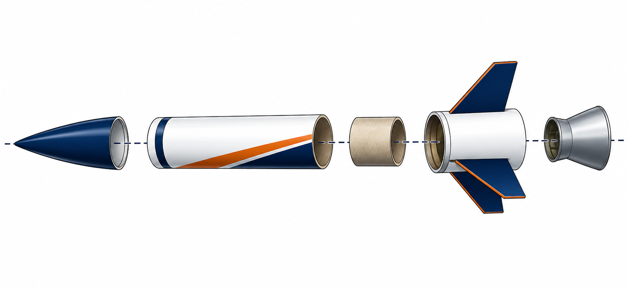
Unit 1 Close
You now have the visual communication tools needed to sketch, measure, document, and propose improvements to aerospace assemblies.
Next: Unit 2 turns sketches and measurements into CAD models and 3D printed parts.

